Slide 1
LHC Upgrade
Part 4:
RF systems for the LHC upgrade
Erk Jensen/CERN
Beams Department
Radio Frequency Group

Slide 2
Outline
This will include the existing RF system …
… and loads of general reminders
I limit myself to the LHC, but upgrades will be implemented also to the LHC injector chain.
Reminders:
  Synchrotron beam dynamics
  Impedance
  Stability limit
The LHC RF systems
  acceleration system
  transverse damper
The HL-LHC Crab cavity system
N.B.: I’m oversimplifying and not rigorous!
Those experts among you: forgive me – I’ll try to reach the others.

Slide 3
Reminder: Synchrotron beam dynamics
Homogeneous magnetic field – circular motion
Inertia force = restoring force:
During acceleration (increasing p), B is permanently increased in order to keep R constant.
Particles with different initial position/angle are kept inside the beam pipe with focusing elements.
Off momentum particles have a slightly different orbit; this is described by the “momentum compaction” :

Slide 4
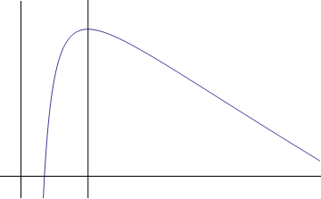
Reminder: Revolution frequency - transition
The revolution frequency results from .
Off-momentum particles also have a different revolution frequency – and this for two effects:
  since they have a different speed,
  since they travel a larger distance (due to momentum compaction):
At lower energy effect 1 dominates,
i.e. increases with energy.
At higher energy effect 2 dominates,
i.e. decreases with energy.
The energy with
is called transition energy.
The LHC is operated above transition.
f

Slide 5
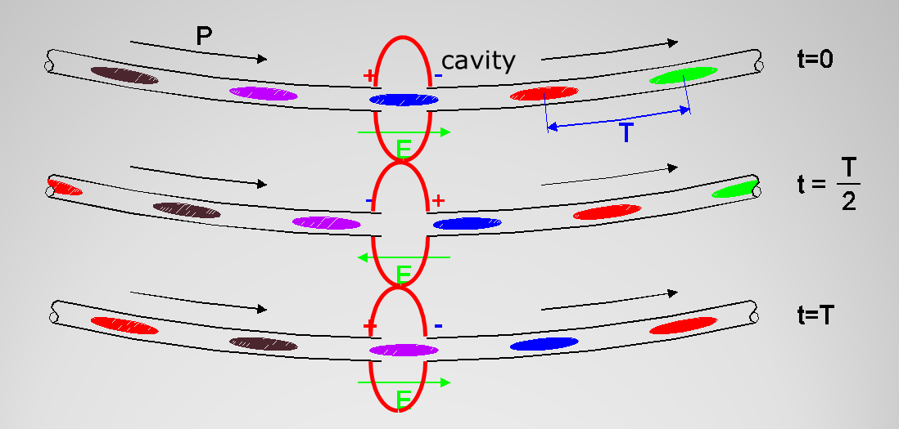
Reminder: Acceleration
Acceleration takes place by interaction with Radio Frequency (RF) electric fields in so-called cavities.
For this to work, protons come in packages (bunches inside of buckets)– h buckets fit on the circumference (h: harmonic number).
The Radio Frequency then has to be h f_{rev}.

Slide 6
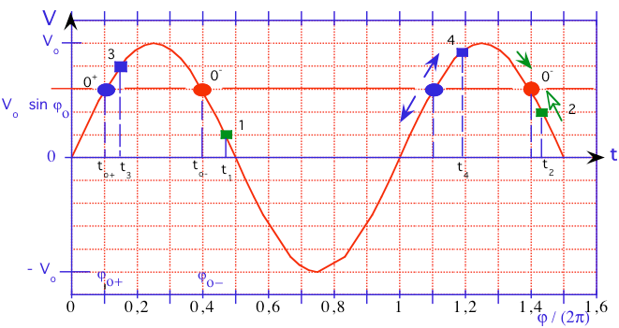
Reminder: Phase stability
Let the gap voltage in the cavity be ;
A particle traversing it at time (phase) changes its energy by .
If this is exactly the right amount of energy in order to get to this same gap at exactly the right phase again the next time around,
is called the synchronous phase.
It is stable if particles next to it see a restoring force towards it.
Below transition the stable phase is , above transition it is .
When passing transition, the RF phase has to be switched.

Slide 7
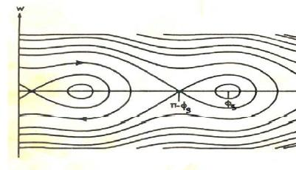
Reminder: Synchrotron motion
The motion of particles around the stable phase
Example shown:
above transition
N.B.: incoherent
synchrotron motion
keeps the particles
of a bunch together.
Coherent synchrotron
motion interacts with
the impedance.

Slide 8
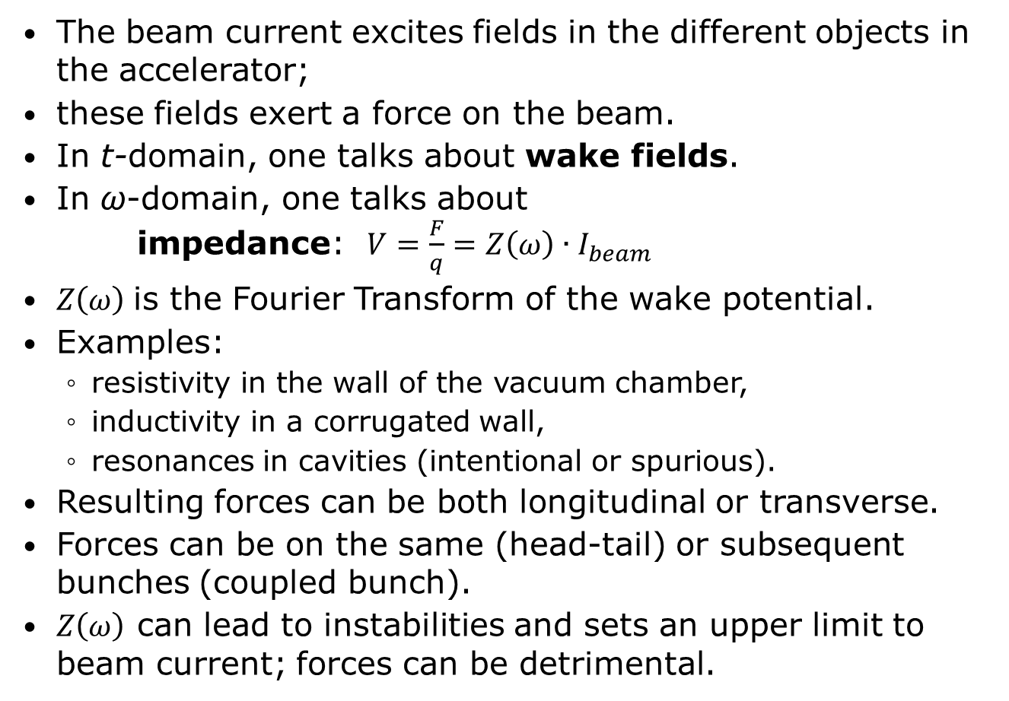
Reminder: Impedance
The beam current excites fields in the different objects in the accelerator;
these fields exert a force on the beam.
In t-domain, one talks about wake fields.
In ω-domain, one talks about
impedance: $V=\frac{F}{q}=Z\left(ω\right)∙I_{beam}$
$Z\left(ω\right)$is the Fourier Transform of the wake potential.
Examples:
  resistivity in the wall of the vacuum chamber,
  inductivity in a corrugated wall,
  resonances in cavities (intentional or spurious).
Resulting forces can be both longitudinal or transverse.
Forces can be on the same (head-tail) or subsequent bunches (coupled bunch).
$Z\left(ω\right)$ can lead to instabilities and sets an upper limit to beam current; forces can be detrimental.

Slide 9
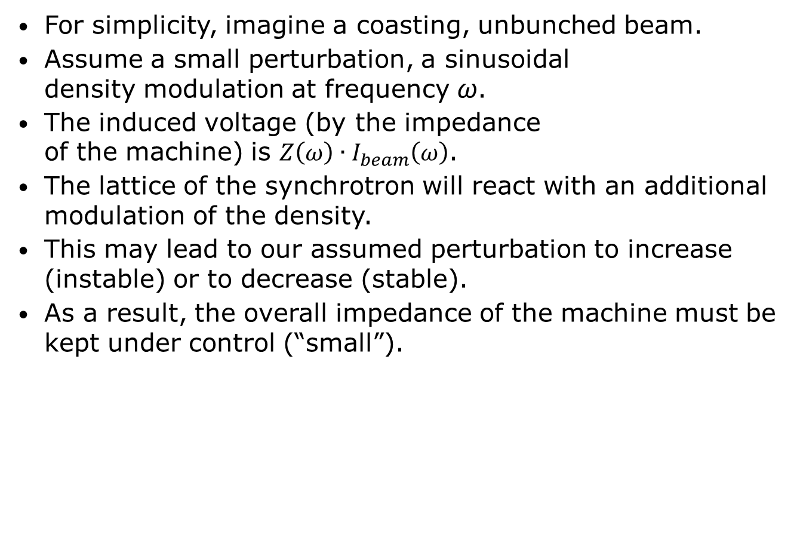
Stability limit
For simplicity, imagine a coasting, unbunched beam.
Assume a small perturbation, a sinusoidal
density modulation at frequency ω.
The induced voltage (by the impedance
of the machine) is $Z\left(ω\right)∙I_{beam}\left(ω\right)$.
The lattice of the synchrotron will react with an additional modulation of the density.
This may lead to our assumed perturbation to increase (instable) or to decrease (stable).
As a result, the overall impedance of the machine must be kept under control (“small”).

Slide 10
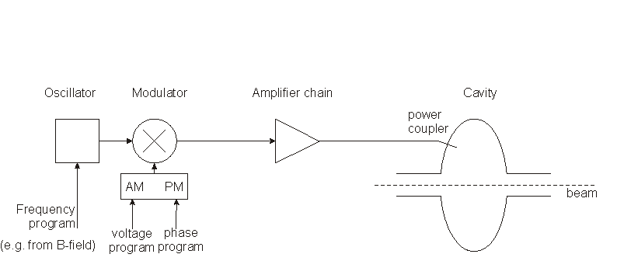
A minimal RF system
Low-level RF
High-Power RF
The frequency has to be controlled to follow the magnetic field such that the beam remains in the centre of the vacuum chamber.
The voltage has to be controlled to allow for capture at injection, a correct bucket area during acceleration, matching before ejection; phase may have to be controlled for transition crossing and for synchronisation before ejection.

Slide 11
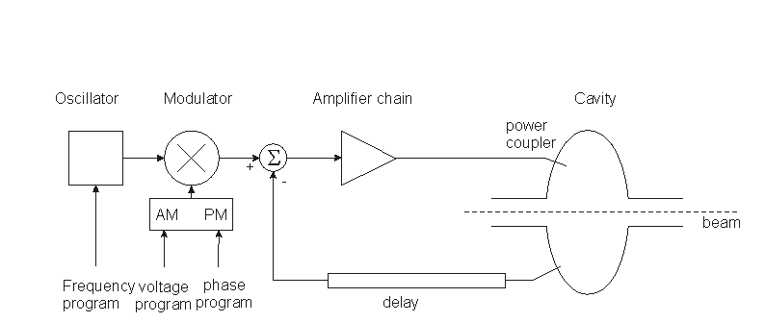
Adding a fast (direct) feedback
Low-level RF
High-Power RF
Compares actual RF voltage and phase with desired and corrects.
Rapidity limited by total group delay (path lengths) (some 100 ns).
Unstable if loop gain =1 with total phase shift 180 ° – design requires to stay away from this point (stability margin)
The group delay limits the gain·bandwidth product.
Works also to keep voltage at zero for strong beam loading, i.e. it reduces the beam impedance.

Slide 12
1-turn delay feedback
The speed of the “fast RF feedback” is limited by the group delay – this is typically a significant fraction of the revolution period.
How to lower the impedance over many harmonics of the revolution frequency?
The beam spectrum is limited
to relatively narrow bands
around the multiples of the
revolution frequency.
Only in these narrow bands
the loop gain must be high!
Install a comb filter! … and
extend the group delay to exactly
one turn – in this case the loop will
have the desired effect and remain
stable.

Slide 13
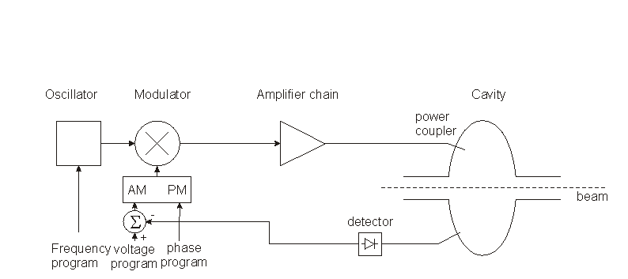
Field amplitude control (AVC)
Low-level RF
High-Power RF
Compares the detected cavity voltage to the voltage program. The error signal serves to correct the amplitude

Slide 14
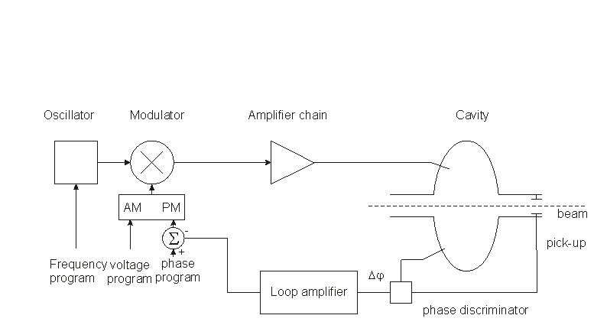
Beam phase loop
Low-level RF
High-Power RF
Longitudinal motion:
Loop amplifier transfer
function designed to damp synchrotron oscillation.
Modified equation:

Slide 15
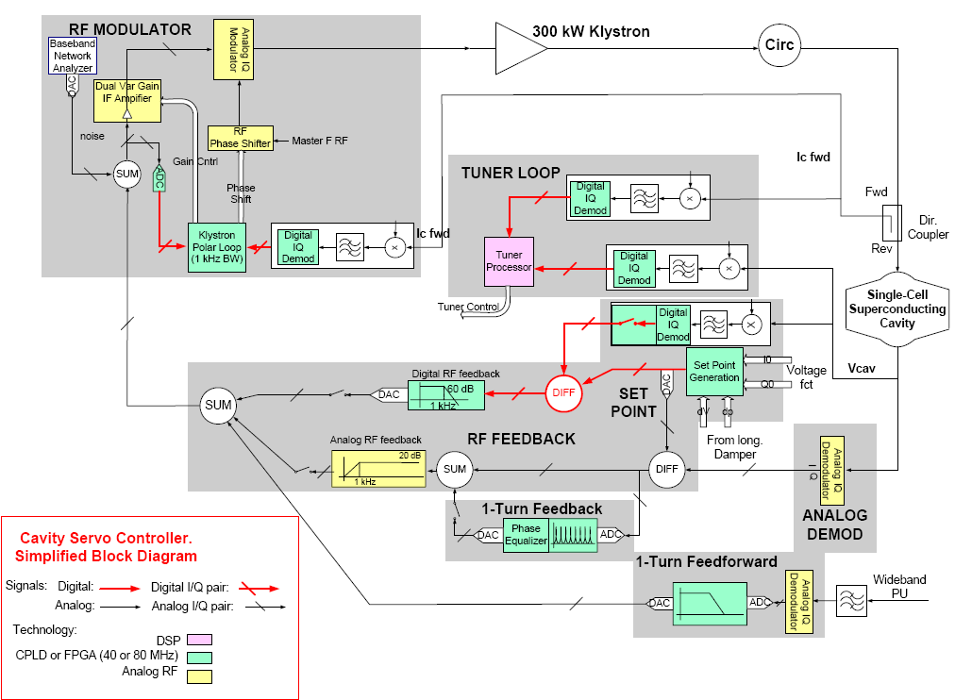
LHC RF System (1/2)
P. Baudrenghien et al

Slide 16
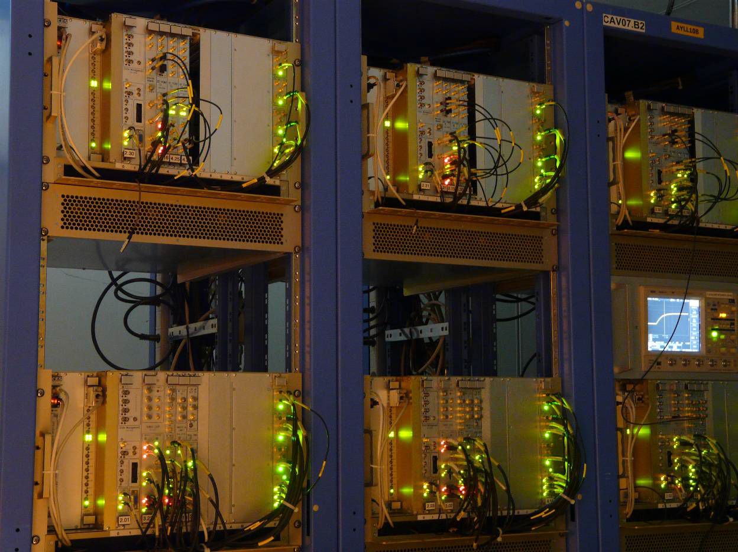
LHC RF System (2/2)
One Rack contains 1 complete cavity controler
From: LHC Project Report 1172

Slide 17
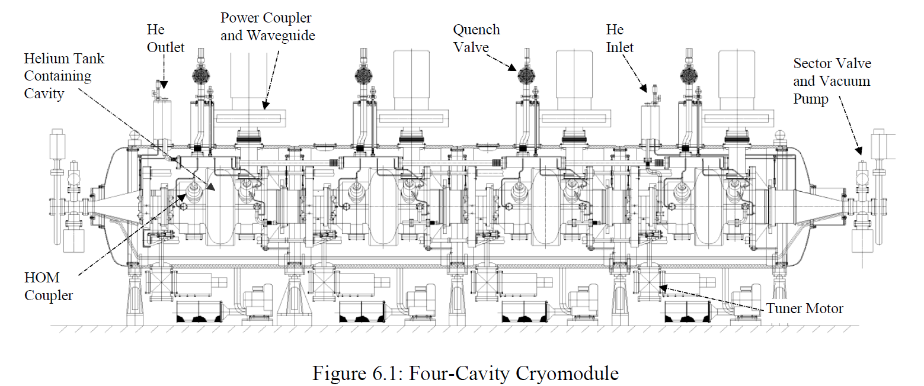
LHC SC RF, 4 cavity module, 400 MHz

Slide 18
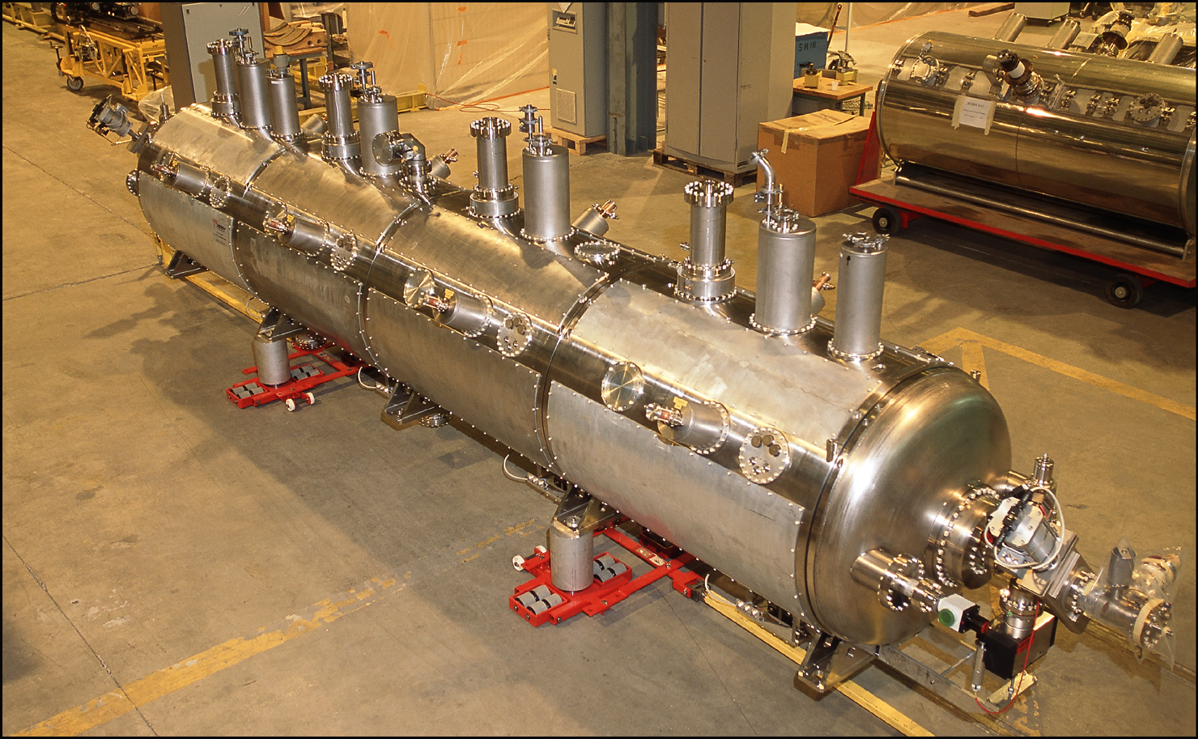
LHC SC RF, 4 cavity module, 400 MHz

Slide 19
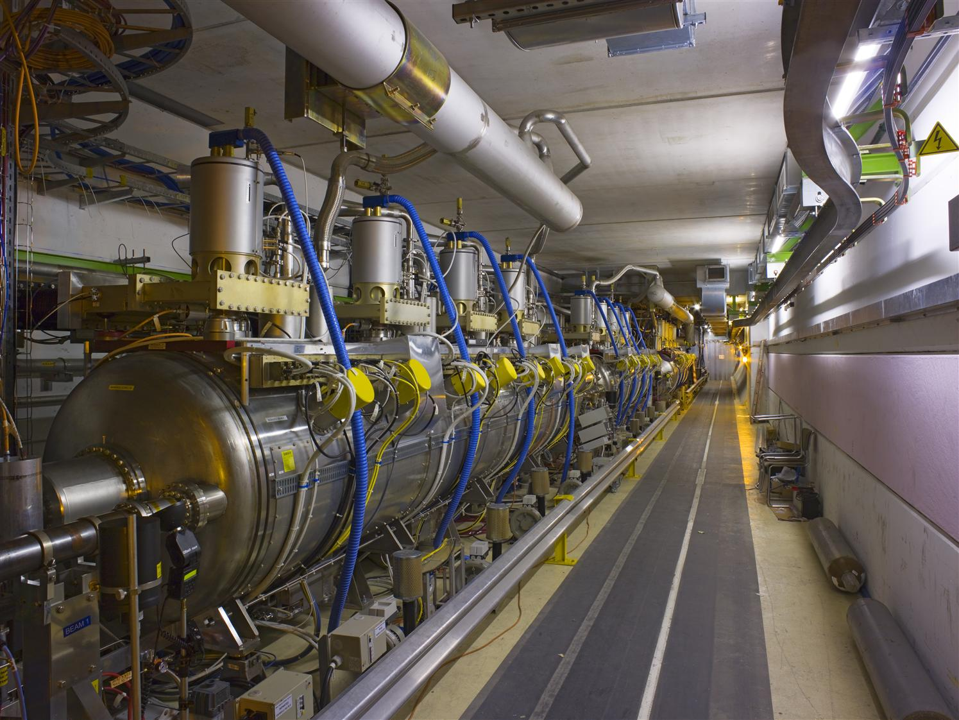
LHC 400 MHz Cavities in the tunnel
2 cryomodules (x 4 cavities) left of IR4
(similar right of IR4)
8 cavities per beam

Slide 20
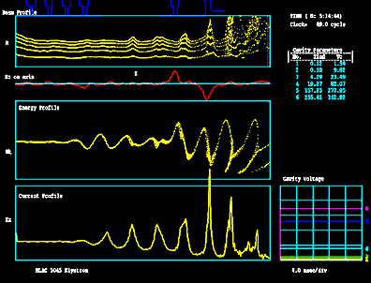
Klystron principle

Slide 21
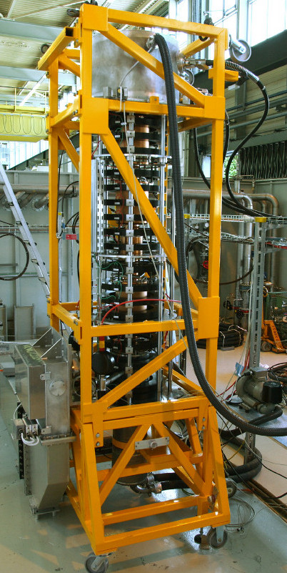
LHC RF power: klystrons
CERN LHC klystron:
(58 kV, 9.3 A)
400 MHz, 300 kW CW RF,
Efficiency 62 %.
One klystron feeds 1 cavity to
reach 2 MV accelerating voltage.

Slide 22
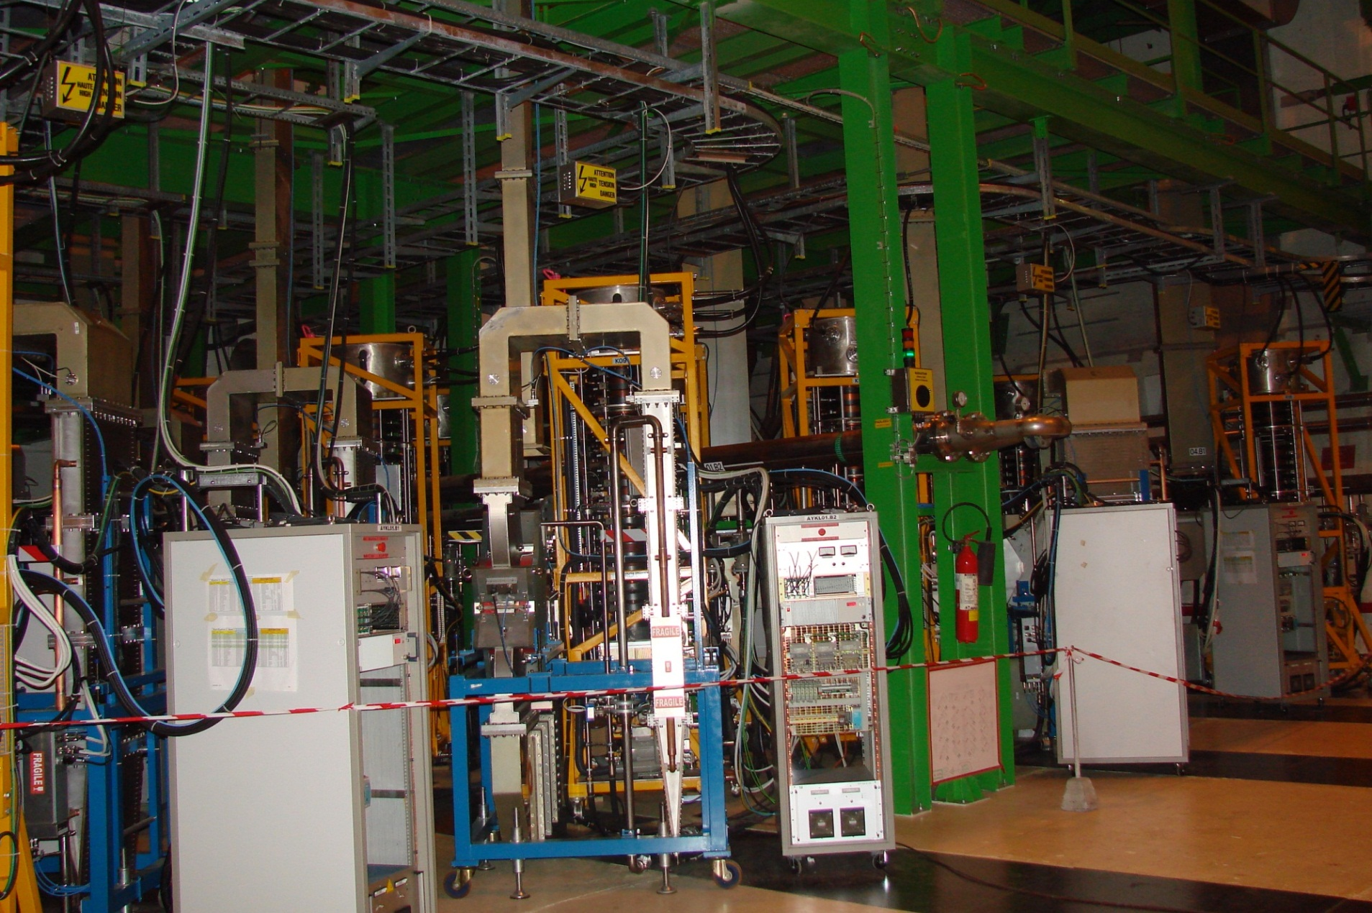
Cavern UX45: LHC Power station, 16 klystrons

Slide 23
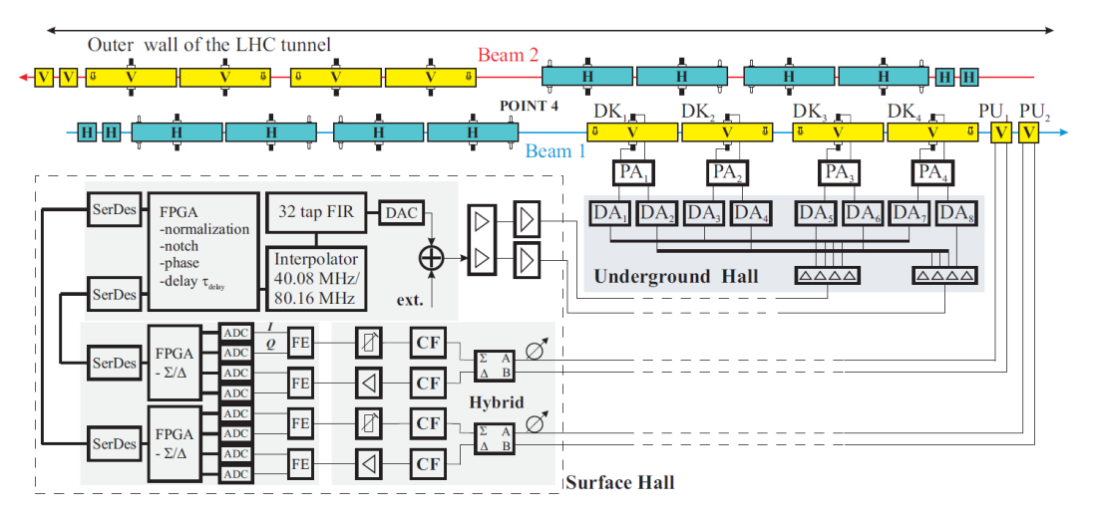
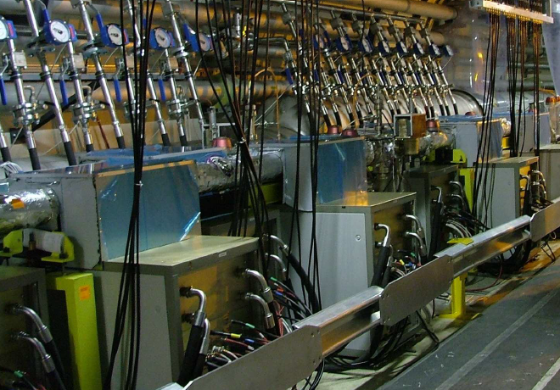
LHC Transverse Damper

Slide 24
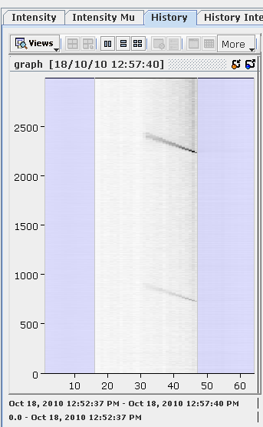
Transverse damper system
Purpose:
  To damp transverse injection errors,
  to create a clean gap for injection and abort
  to keep beam stable transversely.
  Maybe in the future to counteract e-cloud…
Abort gap cleaning

Slide 25
“e-cloud” – limiting the beam current
A passing proton bunch (red) attracts electrons (blue )present in the beam pipe and accelerates them towards the opposite side of the beam chamber.
Hitting the surface results in the emission of secondary electrons – depending on the secondary emission yield (SEY) and the energy of the impacting electrons potentially more than the impacting primary electrons.
For illustration we assume SEY=2.
When the next proton bunch passes, the whole repeats itself, but the electron density increases. It will reach a steady state since new emissions are counteracted by the potential of the electron cloud.
If the distance between proton bunches is similar to the time of flight of the electrons, there will be a resonant effect (similar to multipacting).
The interaction of the e-cloud with the proton bunches will deflect them and may – depending on the proton intensity – lead to beam loss.
This is a serious limitation in the LHC (and the SPS).

Slide 26
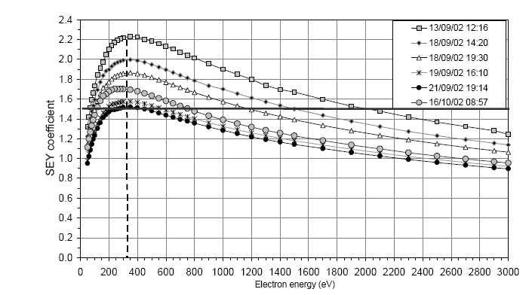
Secondary Emission Yield (SEY)
Typical behaviour
of the SEY as function
of the energy of the
impacting primary
electrons for different
conditioning.
In order to reduce the adverse effects of e-cloud, one may
  change the bunch spacing,
  condition the vacuum chamber surface, e.g. by controlled particle loss (scrubbing – see above diagram),
  coat the inside of the vacuum chamber (Ti, TiN, NEG, a-C, ...),
  change the geometry of surface aspect of the vacuum chamber (longitudinal corrugation or roughen surface),
  apply additional electric (clearing electrode) or magnetic fields deflect electrons thus destroying the resonance condition,
  Maybe implement a very fast (wide-band) transverse damper to correct proton trajectories.

Slide 27


LHC Luminosity upgrade
Crab Cavities

Slide 28
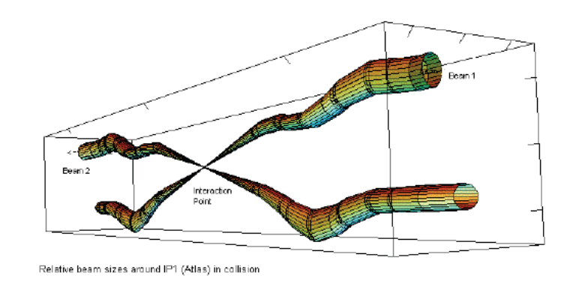
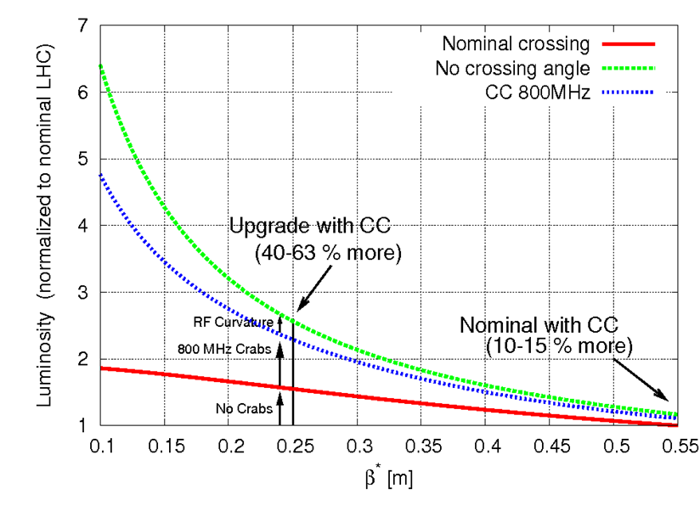
Crab Cavities – context
Many bunches require non-zero crossing angle to avoid parasitic collisions and to reduce beam-beam effects;
With non-zero crossing angle, luminosity gain by squeezing beams further is small (red curve below).
Crab cavities can compensate for
this geometric effect and thus
allow for a luminosity increase of
about 50 % at β* of 25 cm.
In addition, crab cavities provide
a knob for luminosity levelling;
This allows optimizing for
integrated rather than peak
luminosity!

Slide 29
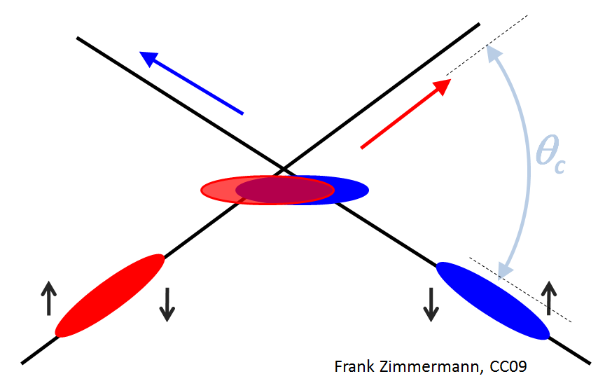
Principle of Crab Cavity operation
RF crab cavity deflects head and tail in opposite direction so that collision is effectively “head on” for luminosity and tune shift
Bunch centroids still cross at an angle (easy separation)

Slide 30
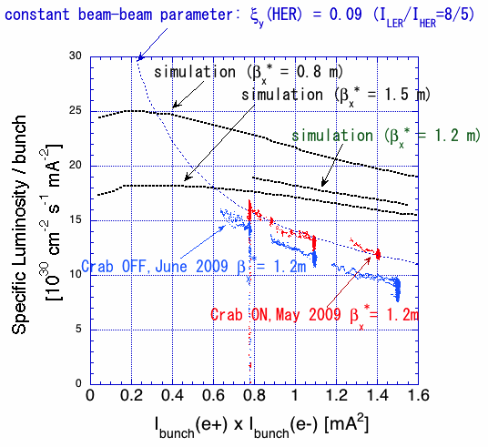
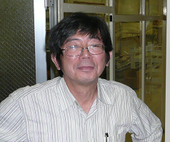
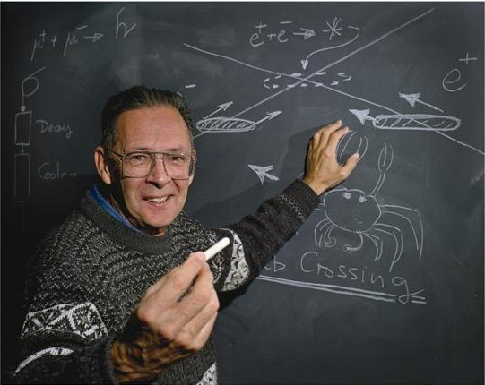
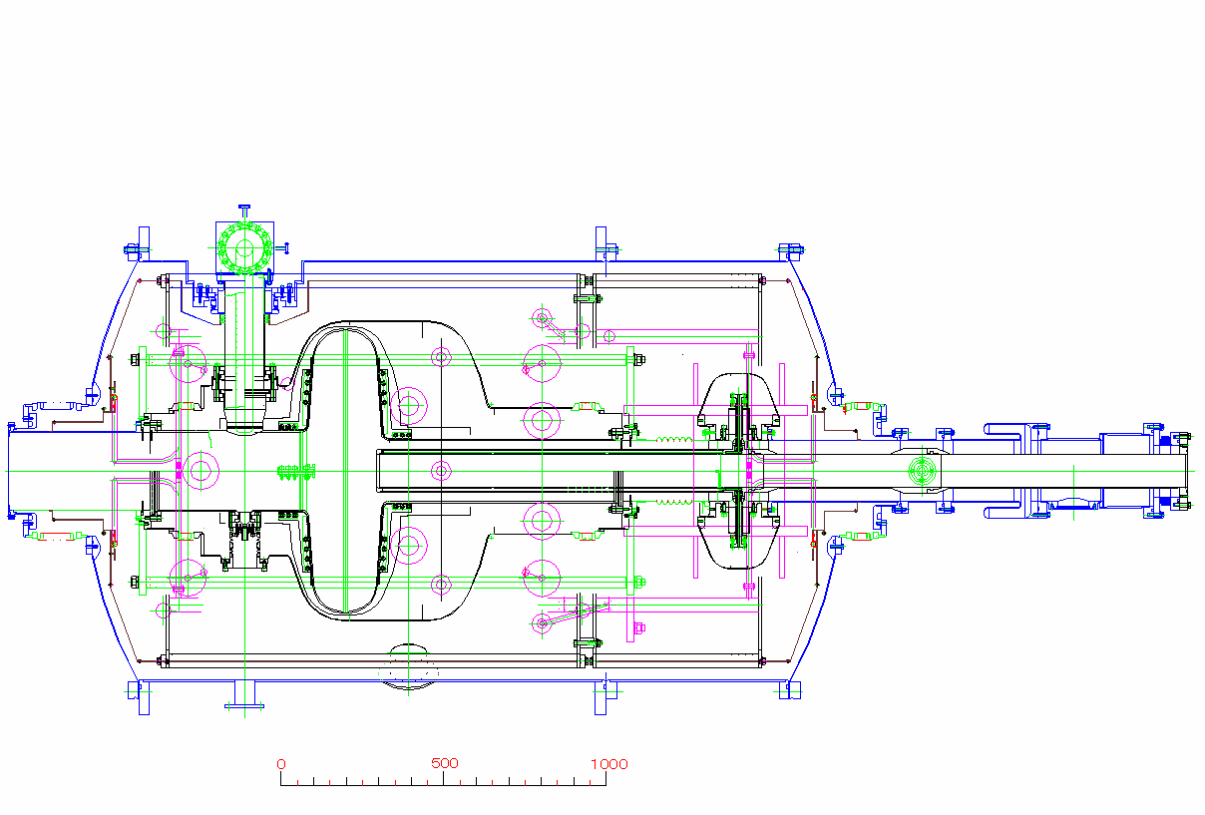
Crab Cavities History: 1988 to 2009
K. Hosoyama, 2010
Elliptical Technology
R. Palmer, 1988, LC
In operation at KEKB 2007 - 2011 → world record luminosity!

Slide 31
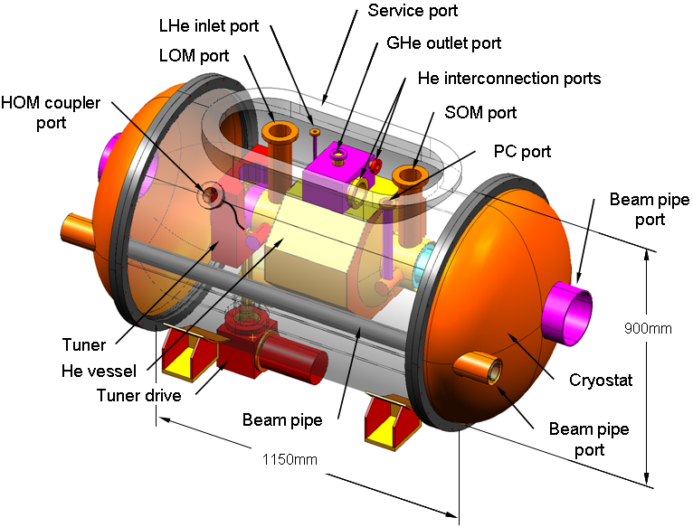
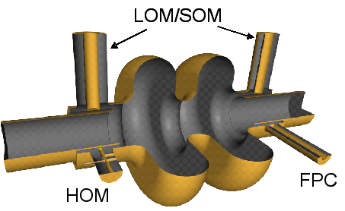
Crab Cavities for LHC
Proposed 2005 US-LARP
First concentrated on elliptical cavities
Y. Yakovlev et al.
L. Xiao et al.
~250 mm outer radius

Slide 32
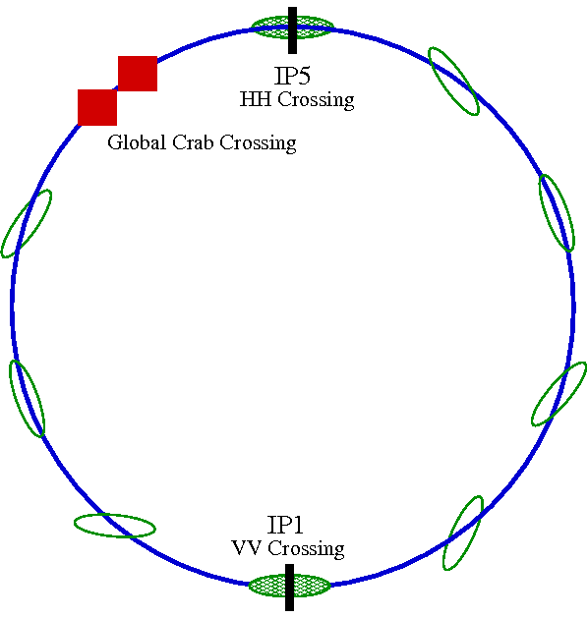
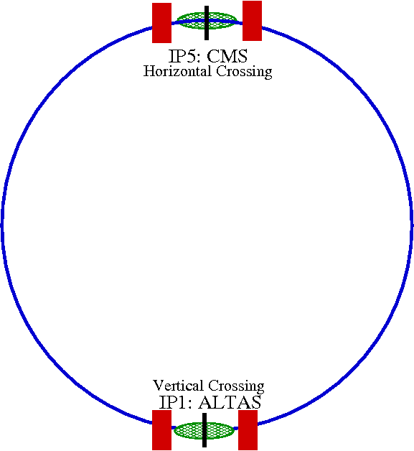
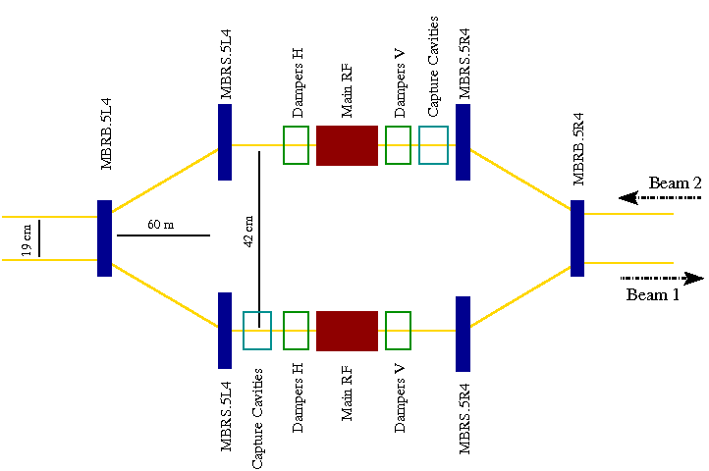
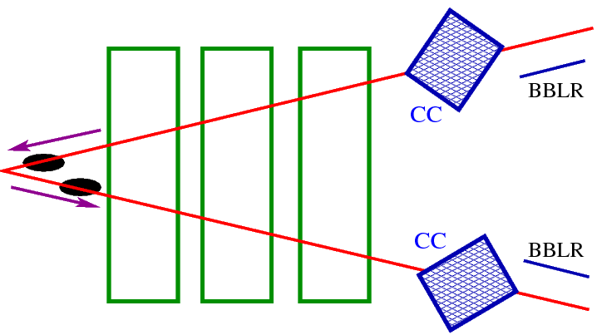
Local versus global crabbing scheme (1/2)
Global scheme, allows for elliptical CC’s at one (or two) locations
Local scheme, CC’s up- and downstream of each IP, requires compact cavities

Slide 33
Local versus global crabbing scheme (2/2)
Global Scheme:
Local Scheme:
Advantages:
Only one cavity per beam;
Larger beam separation near IP4;
Elliptical cavity of known technology.
Disadvantages:
Constraining betatron phase advance;
Requires larger collimator settings;
Works only for H or V crossing;
Only 800 MHz or higher fits.
Fit only in IR4
Advantages:
Individual luminosity control at each IP;
Adapted to H or V crossing;
Orbit perturbed only locally;
Could work lower f – better performance.
Disadvantages/concerns:
Requires novel Compact Cavities (194 mm separation), well advancing, but not yet validated;
Requires 4 cavities per IP;
What if 1 cavity trips?

Slide 34
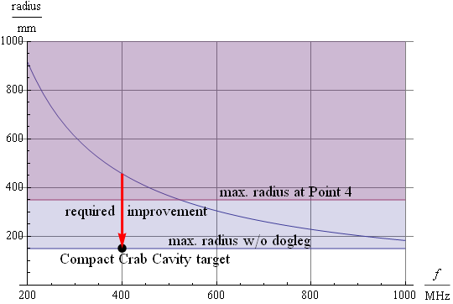
Compact Crab Cavities are needed!
The nominal LHC beam separation
in the LHC is 194 mm;
Conventional (elliptical) cavities
scale with λ – they are too large
even at 800 MHz!
… but at higher f,
the RF curvature
is non-linear!
This is a real
challenge!

Slide 35

Two “classes” of compact cavities
TM type
  ➔ Kick force dominated by
  Variations of elliptical cavity ...
  Half-wave resonator (SLAC)
  Mushroom cavity (FNAL)
  Longitudinal rods (JLAB, ULANC)
TE type (Panofsky-Wenzel: !)
  ➔ Kick force dominated by
  “transverse pillbox” (KEK)
  Parallel bars or spokes:
    Figure-of-8 (CI)
    Spoke cavity (SLAC)
    Parallel bar cavity (JLAB, ODU)

Slide 36
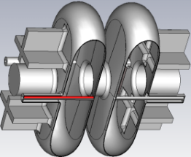
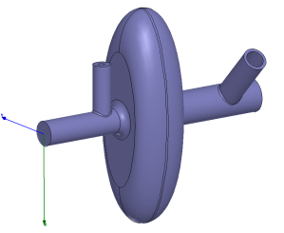
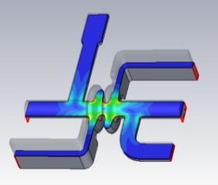
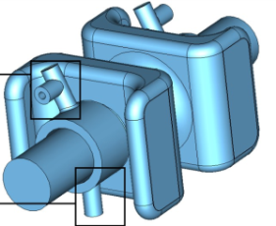
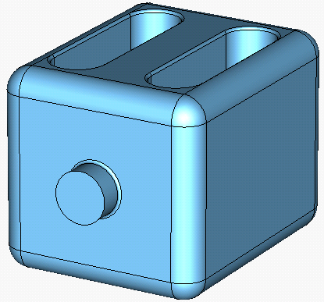
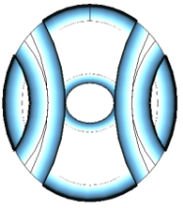
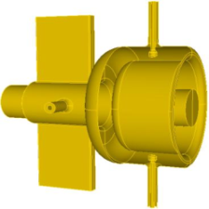
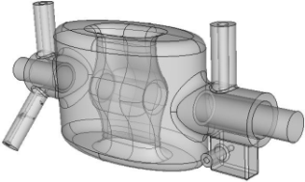
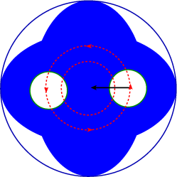
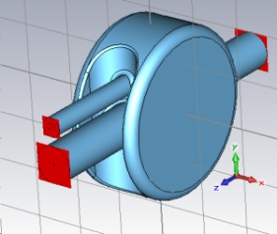
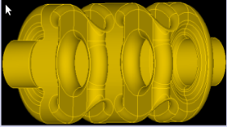
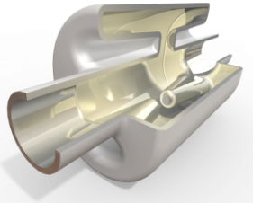
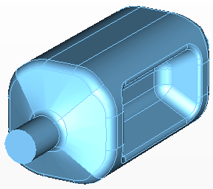
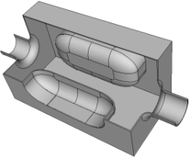



A very interesting and novel field!

Slide 37

Present 400 MHz contenders
Values for 400 MHz, 3 MV integrated kick | Double ridge (ODU/SLAC) | LHC-4R (ULANC) | ¼ Wave (BNL)
Cavity radius [mm] | 147.5 | 143/118 | 142/122
Cavity length [mm] | 597 | 500 | 380
Beam Pipe radius [mm] | 42 | 42 | 42
Peak E-field [MV/m] | 33 | 32 | 47
Peak B-Field [mT] | 56 | 60.5 | 71
RT/Q [Ω] | 287 | 915 | 318
Nearest OOM [MHz] | 584 | 371-378 | 575
500

Slide 38




Challenge: SC RF technology
March 2012:
May 2012:
on-going R&D

Slide 39
Summary – LHC Upgrade RF
LHC RF System consists of acceleration system and transverse damper system.
Elaborate beam control to keep beams stable at all energies and intensities.
16 SC single-cell 400 MHz cavities in 4 cryostats designed for 16 MV/beam.
LHC luminosity upgrade requires compact Crab Cavities, which initiated challenging R&D on SC RF Technology.
Thank you very much!

