Slide 1
Cavity Basics
Erk Jensen
CERN BE-RF

Slide 2
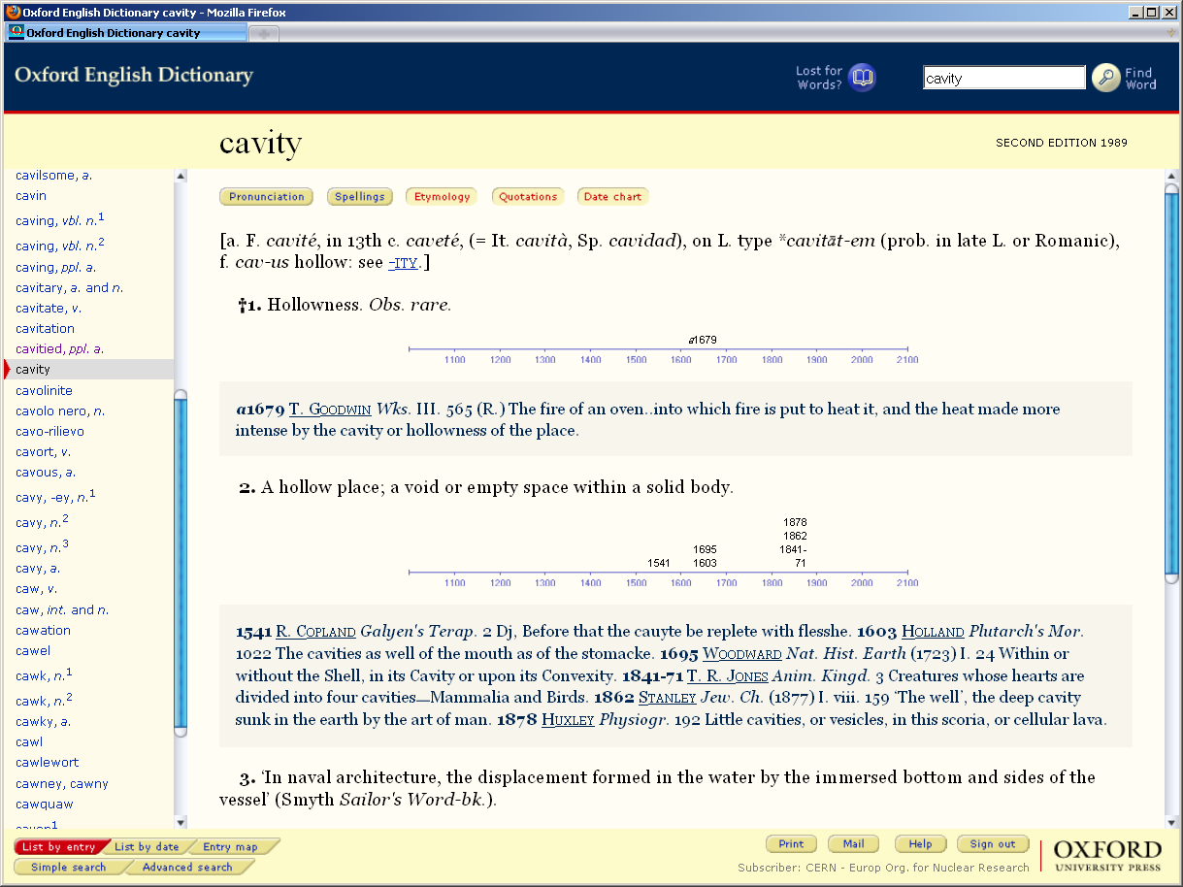
What is a cavity?

Slide 3
Lorentz force
A charged particle moving with velocity through an electromagnetic field experiences a force
The total energy of this particle is , the kinetic energy is
The role of acceleration is to increase the particle energy!
Change of by differentiation:
Note: Only the electric field can change the particle energy!

Slide 4
Maxwell’s equations
The electromagnetic fields inside the “hollow place” obey these equations:
With the curl of the 3rd, the time derivative of the 1st equation and the vector identity
this set of equations can be brought in the form
which is the Laplace equation in 4 dimensions.
With the boundaries of the “solid body” around it (the cavity walls), there exist eigensolutions of the cavity at certain frequencies (eigenfrequencies).

Slide 5
Homogeneous plane wave
Wave vector :
the direction of is the direction of propagation,
the length of is the phase shift per unit length.
behaves like a vector.
x
E_{y}
φ
z

Slide 6
Wave length, phase velocity
The components of are related to the wavelength in the direction of that component as etc. , to the phase velocity as
E_{y}
x
z

Slide 7
Superposition of 2 homogeneous plane waves
E_{y}
x
z
=
+
Metallic walls may be inserted where
without perturbing the fields.
Note the standing wave in x-direction!
This way one gets a hollow rectangular waveguide

Slide 8
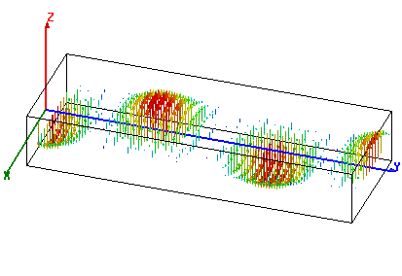
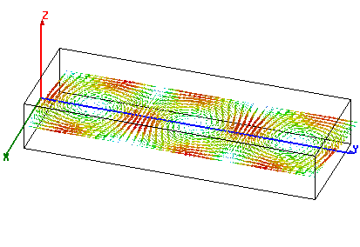
Rectangular waveguide
Fundamental (TE₁₀ or H₁₀) mode
in a standard rectangular waveguide.
Example: “S-band” : 2.6 GHz ... 3.95 GHz,
Waveguide type WR284 (2.84” wide), dimensions: 72.14 mm x 34.04 mm.
Operted at f = 3 GHz.
power flow
electric field
power flow:
magnetic field
power flow

Slide 9
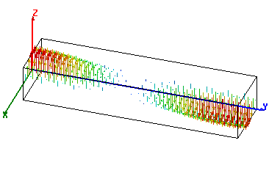
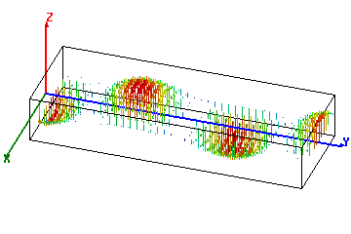
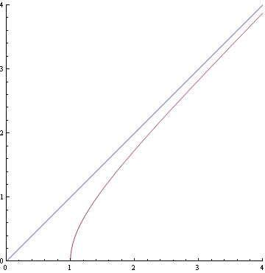
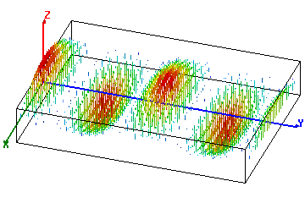
Waveguide dispersion
What happens with different waveguide dimensions (different width a)?
f = 3 GHz
1:
a = 52 mm,
f/f_{c} = 1.04
2:
a = 72.14 mm,
f/f_{c} = 1.44
3
2
3:
a = 144.3 mm,
f/f_{c} = 2.88
1
cutoff

Slide 10
Phase velocity
The phase velocity is the speed with which the crest or a zero-crossing travels in z-direction.
Note on the three animations on the right that, at constant f, it is .
Note that at , !
With , !
f = 3 GHz
1:
a = 52 mm,
f/f_{c} = 1.04
2:
a = 72.14 mm,
f/f_{c} = 1.44
3
2
3:
a = 144.3 mm,
f/f_{c} = 2.88
1
cutoff

Slide 11
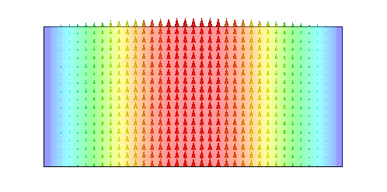
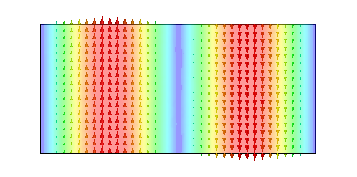
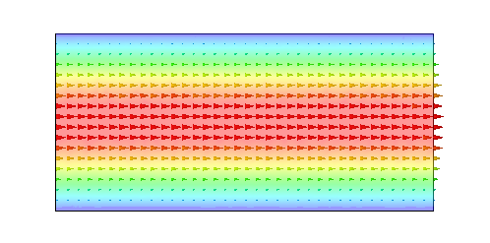
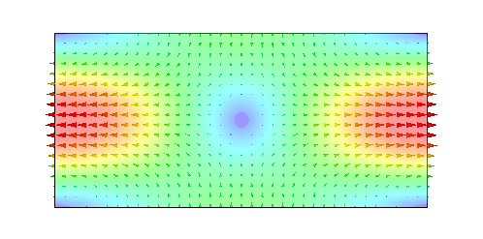
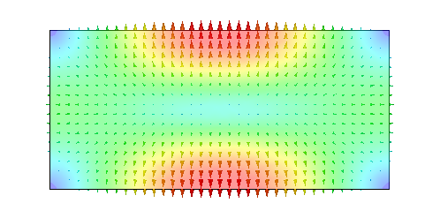
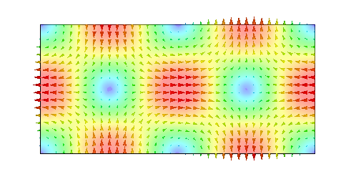
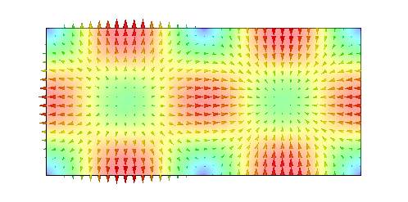
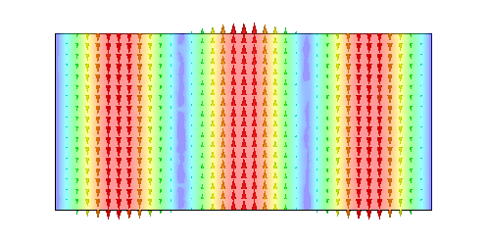
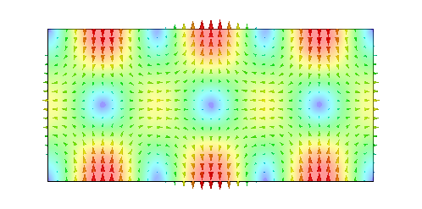
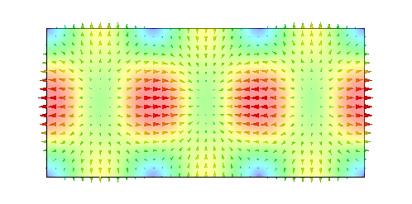
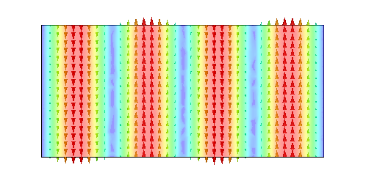
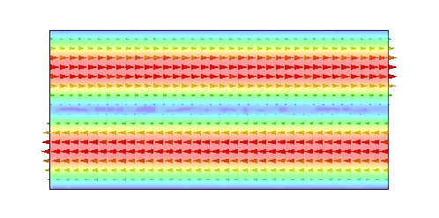
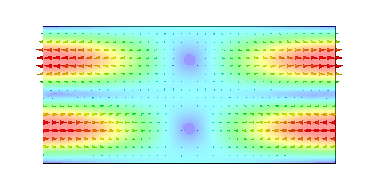
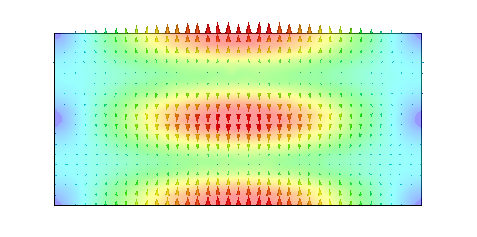
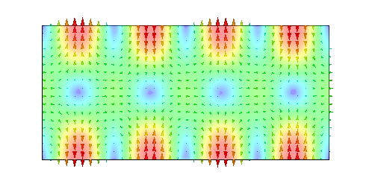
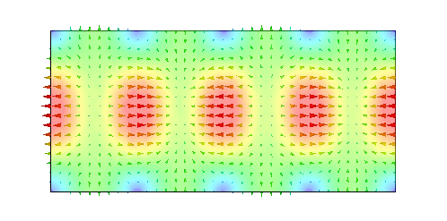
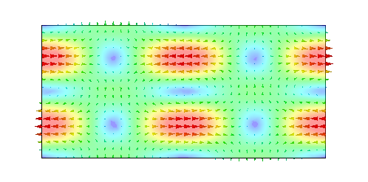
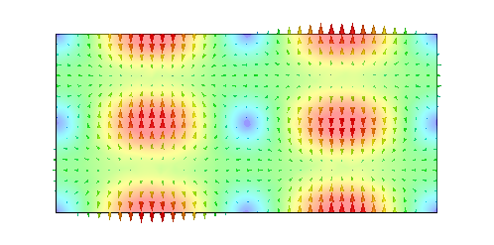
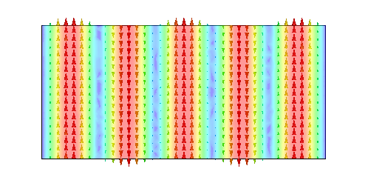
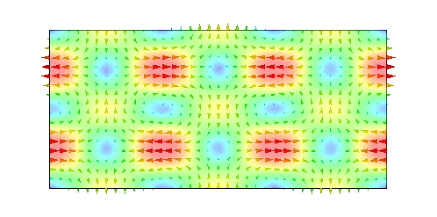
Rectangular waveguide modes
TE₁₀
TE₂₀
TE₀₁
TE₁₁
TM₁₁
TE₂₁
TM₂₁
TE₃₀
TE₃₁
TM₃₁
TE₄₀
TE₀₂
TE₁₂
TM₁₂
TE₄₁
TM₄₁
TE₂₂
TM₂₂
TE₅₀
TE₃₂
plotted: E-field

Slide 12
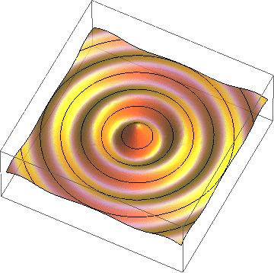
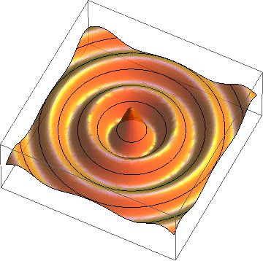
Radial waves
Also radial waves may be interpreted as superpositions of plane waves.
The superposition of an outward and an inward radial wave can result in the field of a round hollow waveguide.

Slide 13
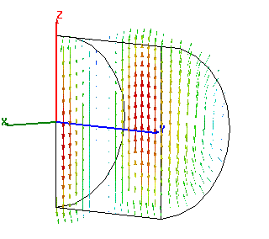
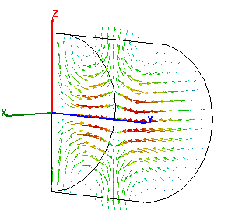
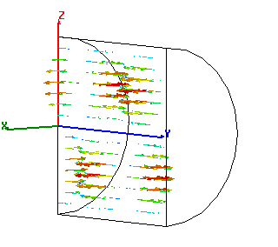
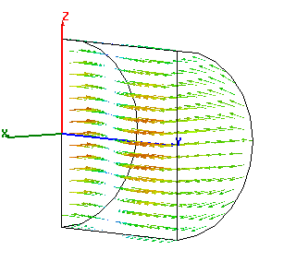
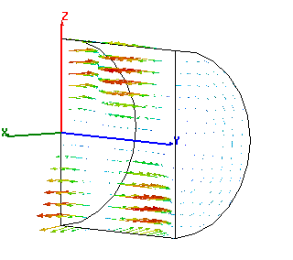
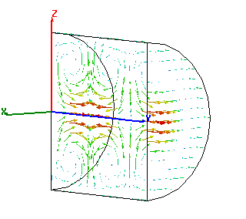
Round waveguide
f/f_{c} = 1.44
TE₁₁ – fundamental
TM₀₁ – axial field
TE₀₁ – low loss

Slide 14
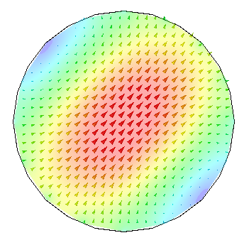
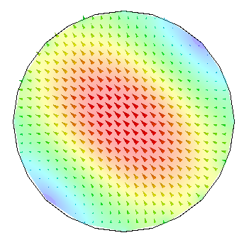
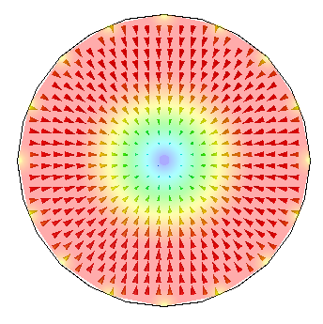
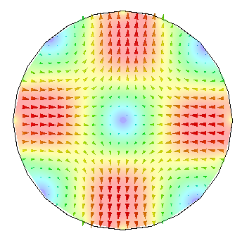
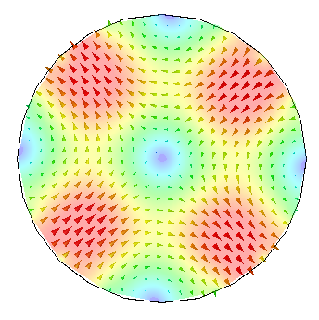
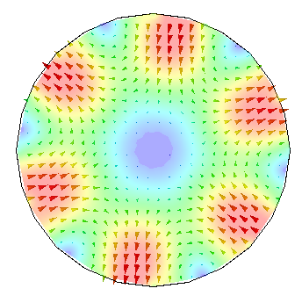
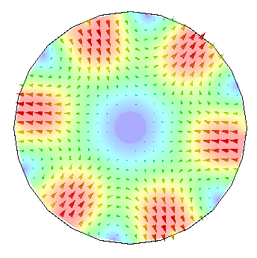
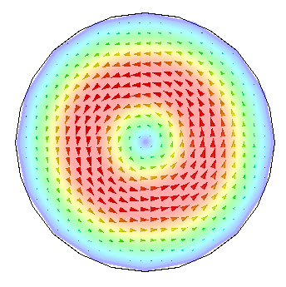
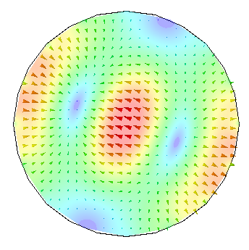
Circular waveguide modes
TE₁₁
TE₁₁
TM₀₁
TE₂₁
TE₂₁
TE₃₁
TE₃₁
TE₀₁
TM₁₁
plotted: E-field

Slide 15
General waveguide equations:
Transverse wave equation (membrane equation):
TE (or H) modes
TM (or E) modes
boundary condition:
longitudinal wave equations
(transmission line equations):
propagation constant:
characteristic impedance:
ortho-normal eigenvectors:
transverse fields:
longitudinal field:

Slide 16
Rectangular waveguide: transverse eigenfunctions
TE (H) modes:
TM (E) modes:
b
a
Round waveguide: transverse eigenfunctions
TE (H) modes:
Ø = 2a
TM (E) modes:
where

Slide 17
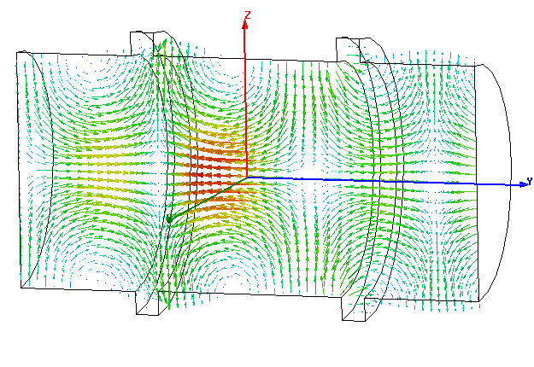
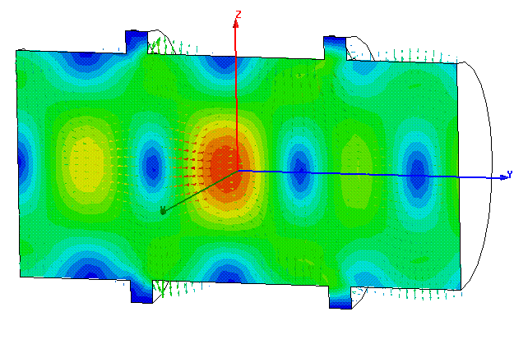
Waveguide perturbed by notches
“notches”
Signal flow chart
Reflections from notches lead to a superimposed standing wave pattern.
“Trapped mode”

Slide 18
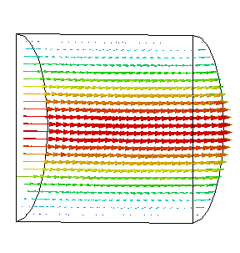
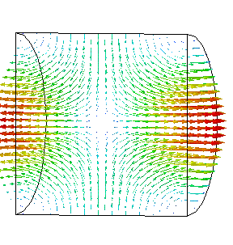
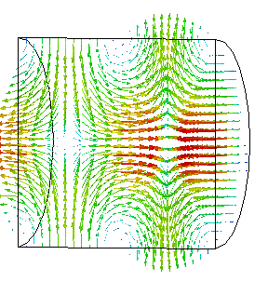
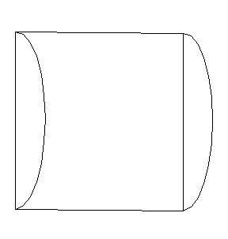
Short-circuited waveguide
TM₀₁₀ (no axial dependence)
TM₀₁₁
TM₀₁₂

Slide 19
Single WG mode between two shorts
short
circuit
short
circuit
Signal flow chart
Eigenvalue equation for field amplitude a:
Non-vanishing solutions exist for :
With , this becomes

Slide 20


Simple pillbox
(only 1/2 shown)
TM₀₁₀-mode
electric field (purely axial)
magnetic field (purely azimuthal)

Slide 21

Pillbox cavity field (w/o beam tube)
h
Ø 2a
The only non-vanishing field components :

Slide 22


Pillbox with beam pipe
TM₀₁₀-mode
(only 1/4 shown)
One needs a hole for the beam pipe – circular waveguide below cutoff
electric field
magnetic field

Slide 23


A more practical pillbox cavity
TM₀₁₀-mode
(only 1/4 shown)
Round of sharp edges (field enhancement!)
electric field
magnetic field

Slide 24
Stored energy
The energy stored in the electric field is
The energy stored in the magnetic field is
Since and are 90° out of phase, the stored energy continuously swaps from electric energy to magnetic energy. On average, electric and magnetic energy must be equal.
The (imaginary part of the) Poynting vector describes this energy flux.
In steady state, the total stored energy is constant in time.

Slide 25



Stored energy & Poynting vector
electric field energy
Poynting vector
magnetic field energy

Slide 26
Losses & Q factor
The losses are proportional to the stored energy .
The cavity quality factor is defined as the ratio .
In a vacuum cavity, losses are dominated by the ohmic losses due to the finite conductivity of the cavity walls.
If the losses are small, one can calculate them with a perturbation method:
  The tangential magnetic field at the surface leads to a surface current.
  This current will see a wall resistance
  { is related to the skin depth by . }
  The cavity losses are given by
  If other loss mechanisms are present, losses must be added.
  Consequently, the inverses of the ‘s must be added!

Slide 27
Small boundary perturbation – tuning
Another application of the perturbation method is to analyse the sensitivity to (small) surface geometry perturbations.
This is relevant to understand the effect of fabrication tolerances.
Intentional surface perturbation can be used to tune the cavity.
The basic idea of the perturbation theory is use a known solution (in this case the unperturbed cavity) and assume that the deviation from it is only small. We just used this to calculate the losses (assuming would be that without losses).
The result of this calculation leads to a convenient expression for the detuning:
V
ΔV
V
unperturbed
perturbed
“Slater-theorem”

Slide 28
Acceleration voltage & R-upon-Q
I define . The exponential factor accounts for the variation of the field while particles with velocity are traversing the gap (see next page).
With this definition, is generally complex – this becomes important with more than one gap. For the time being we are only interested in .
Attention, different definitions are used!
The square of the acceleration voltage is proportional to the stored energy .
The proportionality constant defines the quantity called R-upon-Q:
Attention, also here different definitions are used!

Slide 29

Transit time factor
The transit time factor is the ratio of the acceleration voltage to the (non-physical) voltage a particle with infinite velocity would see.
The transit time factor of an ideal pillbox cavity (no axial field dependence) of height (gap length) h is:
Field rotates by 360° during particle passage.
h/λ

Slide 30
Shunt impedance
The square of the acceleration voltage is proportional to the power loss .
The proportionality constant defines the quantity “shunt impedance”
Attention, also here different definitions are used!
Traditionally, the shunt impedance is the quantity to optimize in order to minimize the power required for a given gap voltage.

Slide 31
Equivalent circuit
Simplification: single mode
I_{G}
I_{B}
V_{acc}
P
Generator
Z
Beam
C
L
R
L=R/(Qω₀)
: coupling factor
C=Q/(Rω₀)
Cavity
R: Shunt impedance
: R-upon-Q

Slide 32
Resonance

Slide 33
Reentrant cavity
Nose cones increase transit time factor, round outer shape minimizes losses.
Example: KEK photon factory 500 MHz - R probably as good as it gets -
this cavity optimized
pillbox
R/Q: 111 Ω 107.5 Ω
Q: 44270 41630
R: 4.9 MΩ 4.47 MΩ
nose cone

Slide 34
Loss factor
Impedance seen by the beam
I_{B}
V (induced)
Beam
Energy deposited by a single charge q:
R/β
C
L
R
L=R/(Qω₀)
C=Q/(Rω₀)
Cavity
Voltage induced by a single charge q:
1
0
-
1
0
5
1
0
1
5
2
0
t f₀

Slide 35
Summary: relations between V_{acc}, W, P_{loss}
R-upon-Q
gap voltage
V_{acc}
Shunt impedance
Energy stored inside the cavity
Power lost in the cavity walls
W
P_{loss}
Q factor

Slide 36
Beam loading – RF to beam efficiency
The beam current “loads” the generator, in the equivalent circuit this appears as a resistance in parallel to the shunt impedance.
If the generator is matched to the unloaded cavity, beam loading will cause the accelerating voltage to decrease.
The power absorbed by the beam is ,
the power loss .
For high efficiency, beam loading should be high.
The RF to beam efficiency is .

Slide 37
Characterizing cavities
Resonance frequency
Transit time factor
  field varies while particle is traversing the gap
Shunt impedance
  gap voltage – power relation
Q factor
R/Q
  independent of losses – only geometry!
loss factor
Circuit definition
Linac definition

Slide 38
Higher order modes
external dampers
R₁, Q₁,ω₁
R₂, Q₂,ω₂
R₃, Q₃,ω₃
...
...
n₁
n₂
n₃
I_{B}

Slide 39

Higher order modes (measured spectrum)
without dampers
with dampers

Slide 40


Pillbox: dipole mode
TM₁₁₀-mode
(only 1/4 shown)
electric field
magnetic field

Slide 41



CERN/PS 80 MHz cavity (for LHC)
inductive (loop) coupling,
low self-inductance

Slide 42


Higher order modes
Example shown:
80 MHz cavity PS for LHC.
Color-coded:

Slide 43
What do you gain with many gaps?
The R/Q of a single gap cavity is limited to some 100 Ω.
Now consider to distribute the available power to n identical cavities: each will receive P/n, thus produce an accelerating voltage of .
The total accelerating voltage thus increased, equivalent to a total equivalent shunt impedance of .
P/n
P/n
P/n
P/n
1
2
3
n

Slide 44

Standing wave multicell cavity
Instead of distributing the power from the amplifier, one might as well couple the cavities, such that the power automatically distributes, or have a cavity with many gaps (e.g. drift tube linac).
Coupled cavity accelerating structure (side coupled)
The phase relation between gaps is important!

Slide 45




Brillouin diagram
Travelling wave structure
π
ω L/c
2π/3
2π
speed of light line,
ω = β /c
π
synchronous
π/2
π/2
0
0
π/2
β L
π

Slide 46

What limits the acceleration
1: The surface electric field:
Approximate limit
for CLIC parameters
(12 GHz, 140 ns,
breakdown rate: 10⁻⁷ m⁻¹):
260 MV/m
Wang & Loew,
SLAC-PUB-7684,
1997
Kilpatrick 1957,
f in GHz, E_{c} in MV/m

Slide 47
What limits the acceleration
2: The surface magnetic field
The surface magnetic field leads to a surface current.
For superconducting cavities, it must stay below a threshold value.
For normal conducting cavities, it will lead to local heating, which in turn can lead to mechanical stress and deformation; with pulsed RF, this can lead to fatigue stress issues. In the presence of an electric field, the heated surface can have an effect on the breakdown.

Slide 48


What limits the acceleration?
3: The (modified) Poynting vector (?)
Even though not yet fully understood, experimental evidence supports the model that a combination of electric and magnetic fields at the surface correlate well with the measured breakdown probability.
http://cdsweb.cern.ch/record/1216861

Slide 49
Cavity basics – Summary
The EM fields inside a hollow cavity are superpositions of homogeneous plane waves.
When operating near an eigenfrequency, one can profit from a resonance phenomenon (with high Q).
R-upon-Q, Shunt impedance and Q factor were are useful parameters, which can also be understood in an equivalent circuit.
The perturbation method allows to estimate losses and sensitivity to tolerances.
Many gaps can increase the effective impedance.

