Slide 1
Cavity Resonators for Accelerators
Erk Jensen
CERN

Slide 2
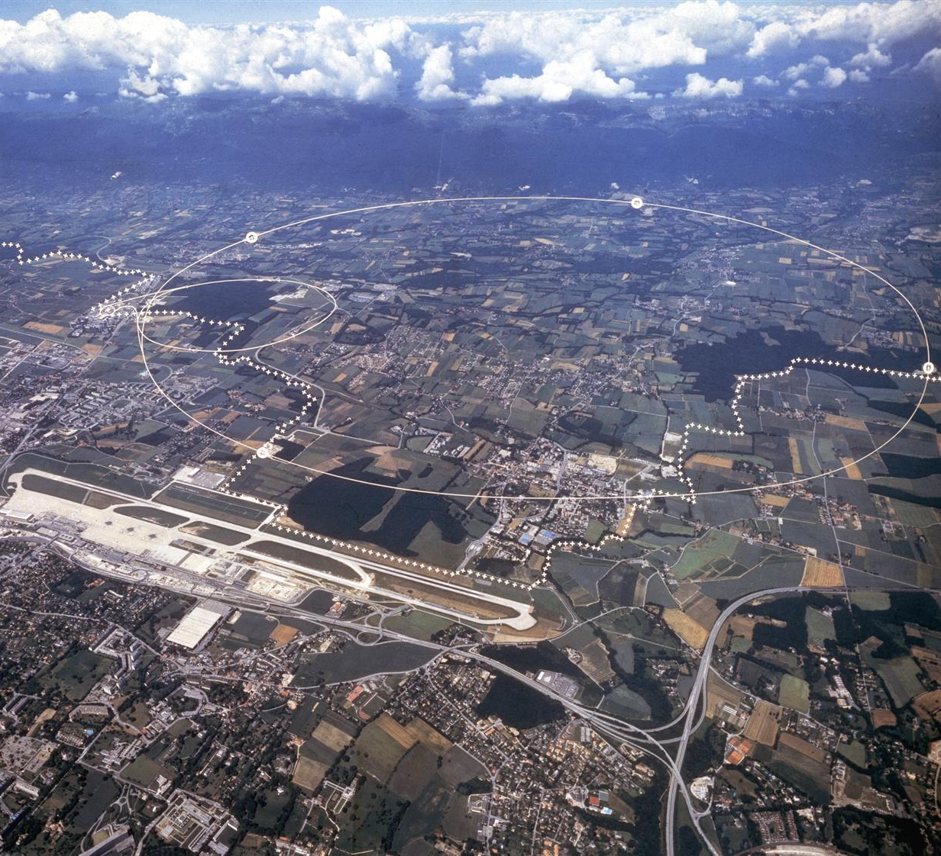
About CERN
Founded 1954
≈ 10,000 people
  2250 staff
annual budget
≈ 0.5 G£
straddling the Franco-Swiss boarder
Jura (looking W)
Meyrin (CH)
LHC
SPS
Prevessin (F)
GVA (Geneva Cointrin airport)

Slide 3
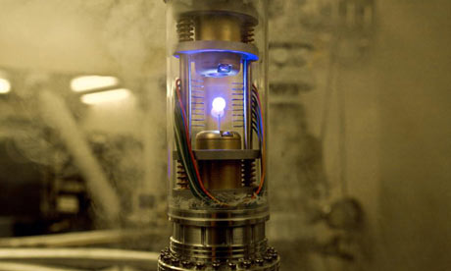
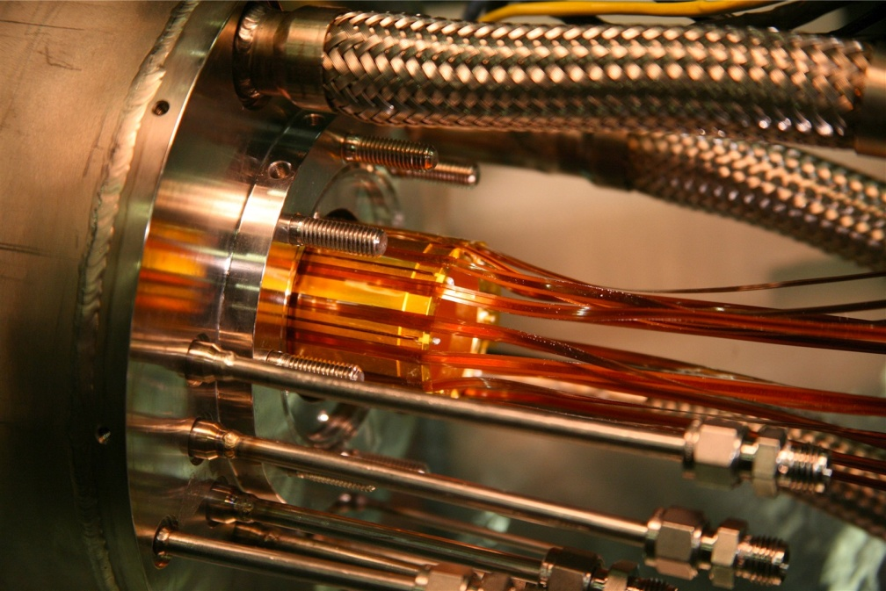
Science – Fiction
FICTION
In the movie “Angels and Demons”, 2009
SCIENCE
In the alpha experiment @ CERN, 2010

Slide 4
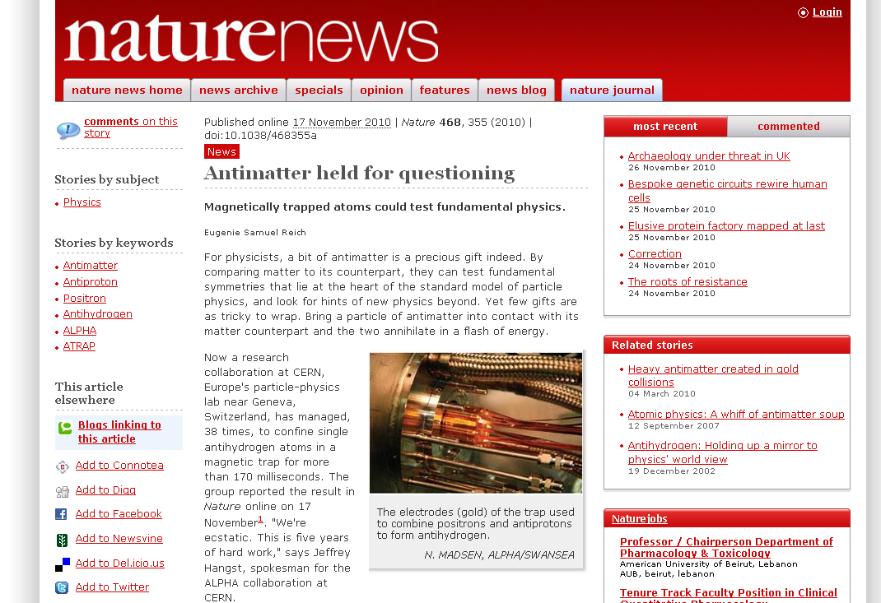
CERN in the news

Slide 5
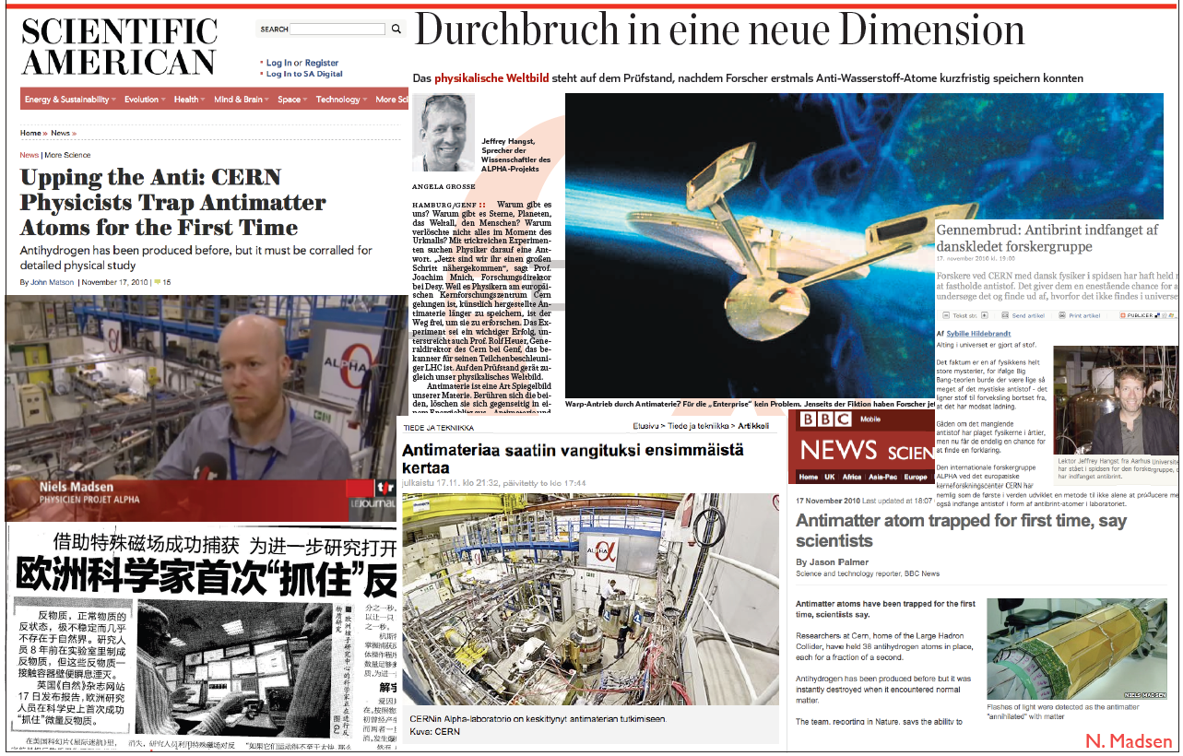
Antimatter trapped

Slide 6
Outline
Introduction
Cavities walking through the CERN accelerator chain
  Ion source – RFQ – Linac 2 – PSB – PS – SPS – LHC
Other accelerating cavities
  Linear Colliders – CLIC – ILC – more exotic cavities

Slide 7
CERN accelerators

Slide 8
0 to 90 keV – The ion source

Slide 9
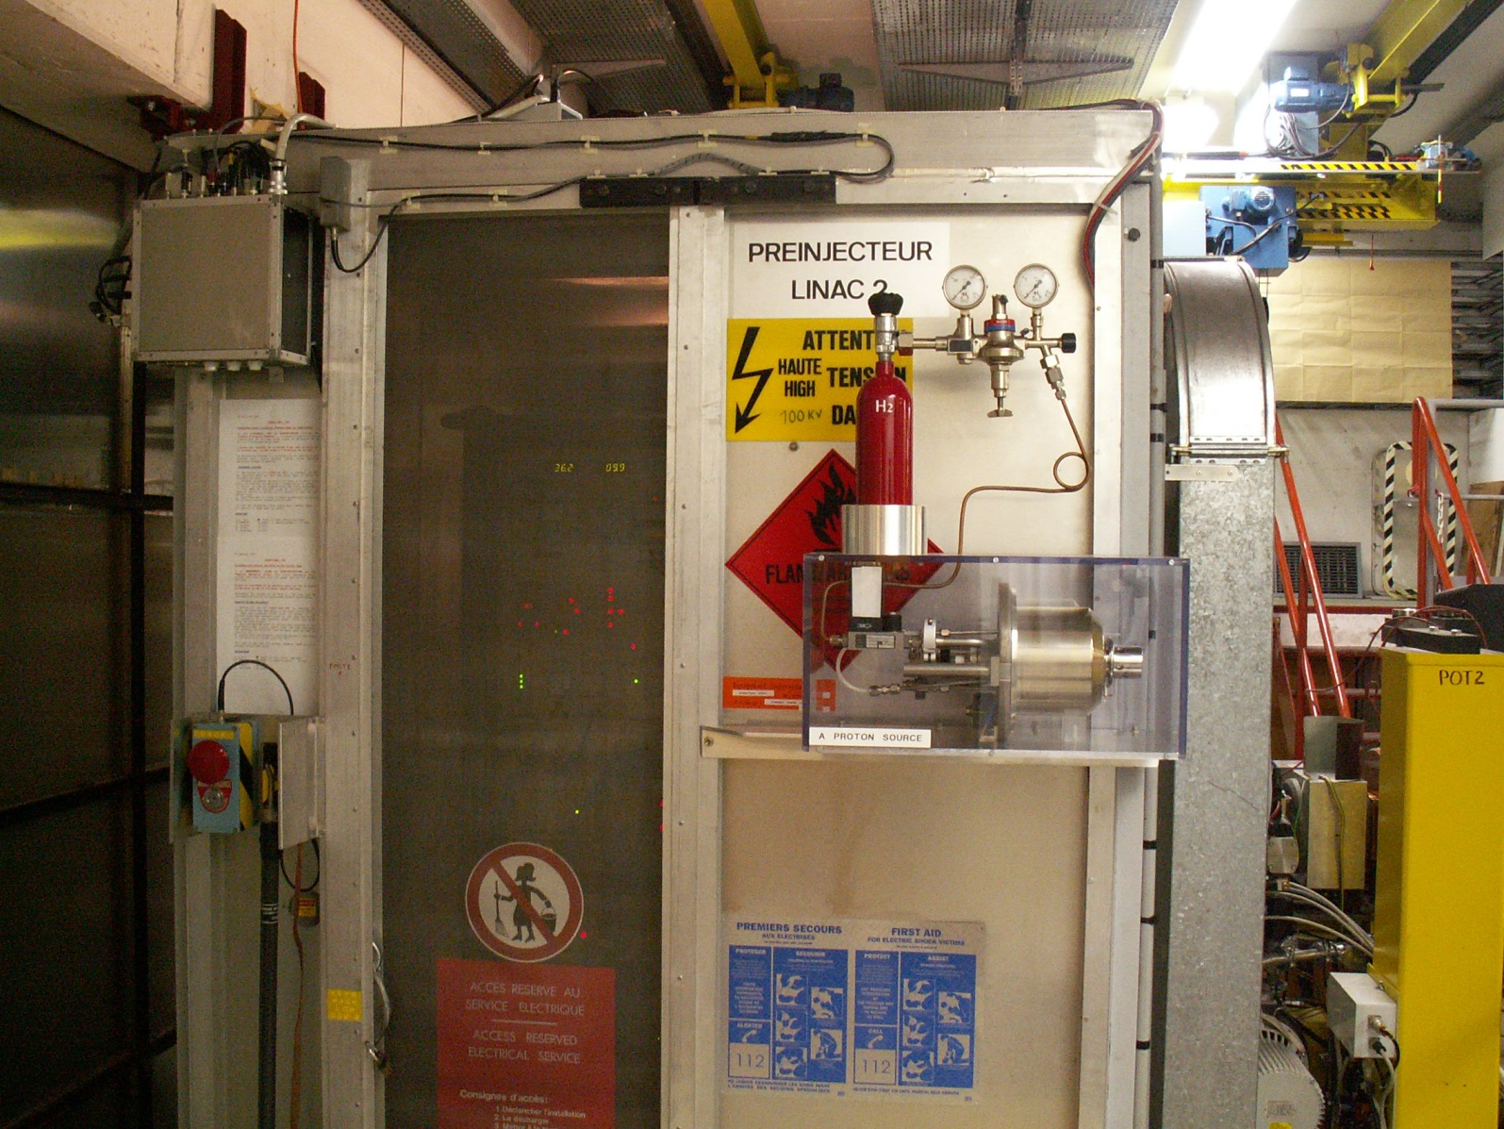
Model of the ion source
Faraday cage containing the real ion source (on 90 kV potential)
Hydrogen bottle
1:1 scale model of the Duoplasmatron
Beam pipe towards RFQ and Linac 2

Slide 10
Duoplasmatron principle
high voltage 90 kV DC
ignition voltage
+ -
- +
magnet coil
Anode
H₂
e⁻
thermionic cathode
H⁺
Intermediate electrode
(magnetic field lines sketched)
expansion chamber with polarisation cylinder
extraction electrode
Pinch to increase
plasma density

Slide 11
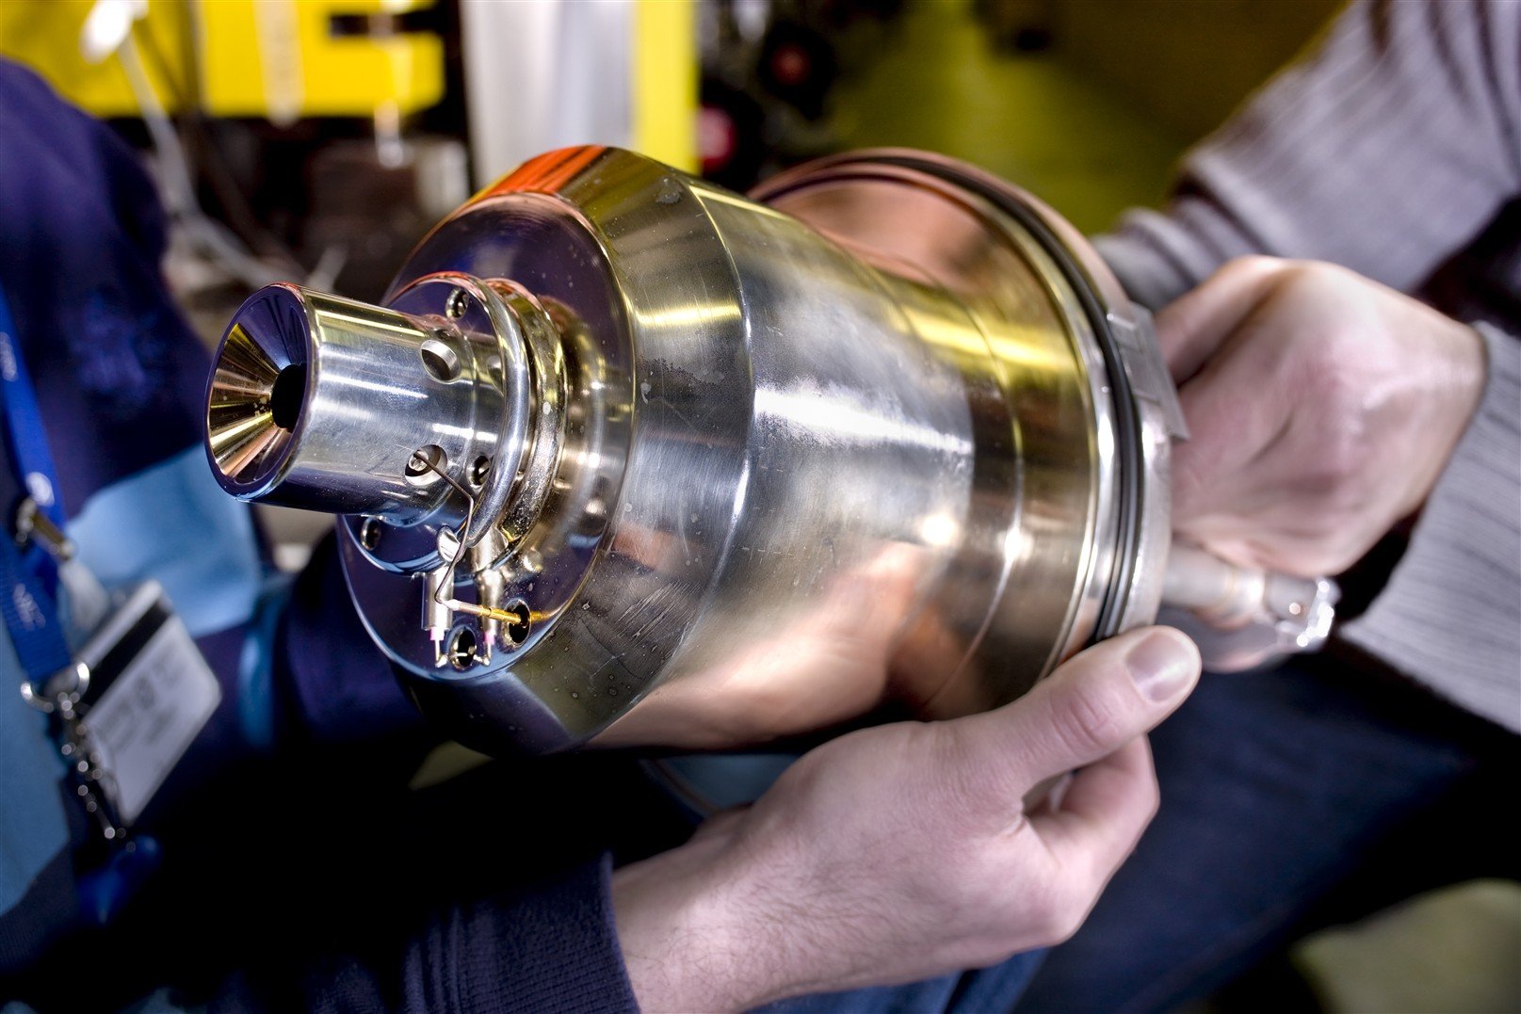
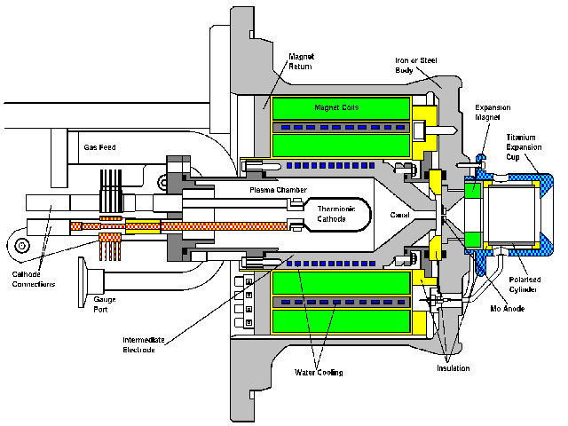
Duoplasmatron - construction

Slide 12
90 to 750 keV – The RFQ
Length: 2 m

Slide 13
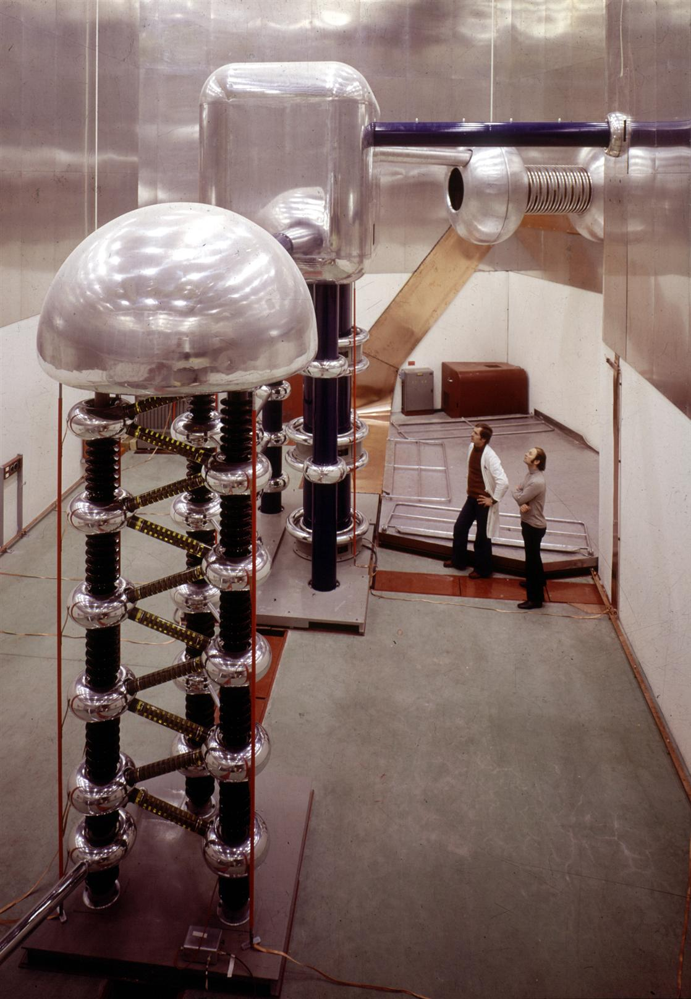
Proton injector before ‘93
Faraday cage, inside ion source and electronics at 750 kV vs. gnd. Potential
Beam pipe to Linac
Cockcroft-Walton generator,
750 kV
In 1993, all this was replace by a 2 m long device ...

Slide 14
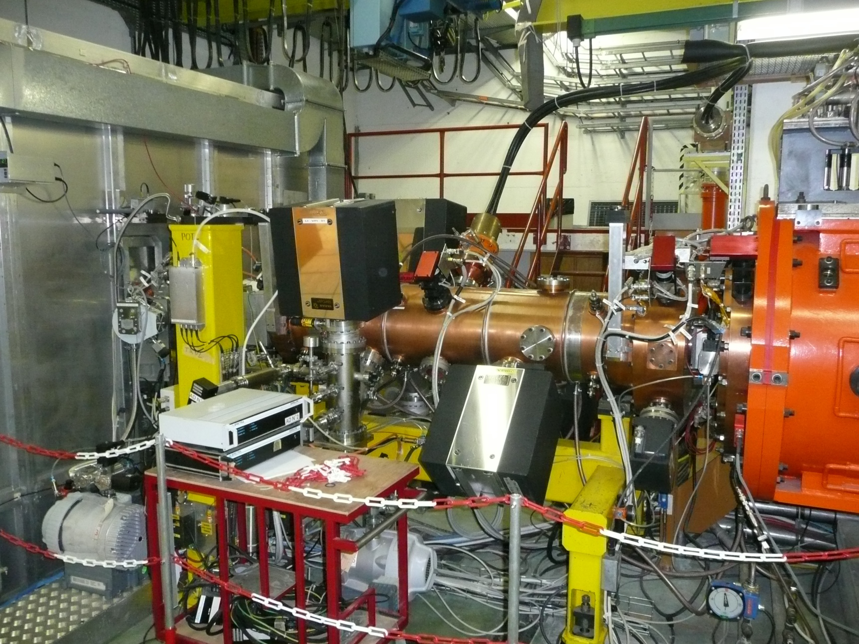
Radio Frequency Quadrupole
Faraday cage (90 kV) containing ion source
RF power feeder lines
RFQ
Linac 2, tank 1

Slide 15
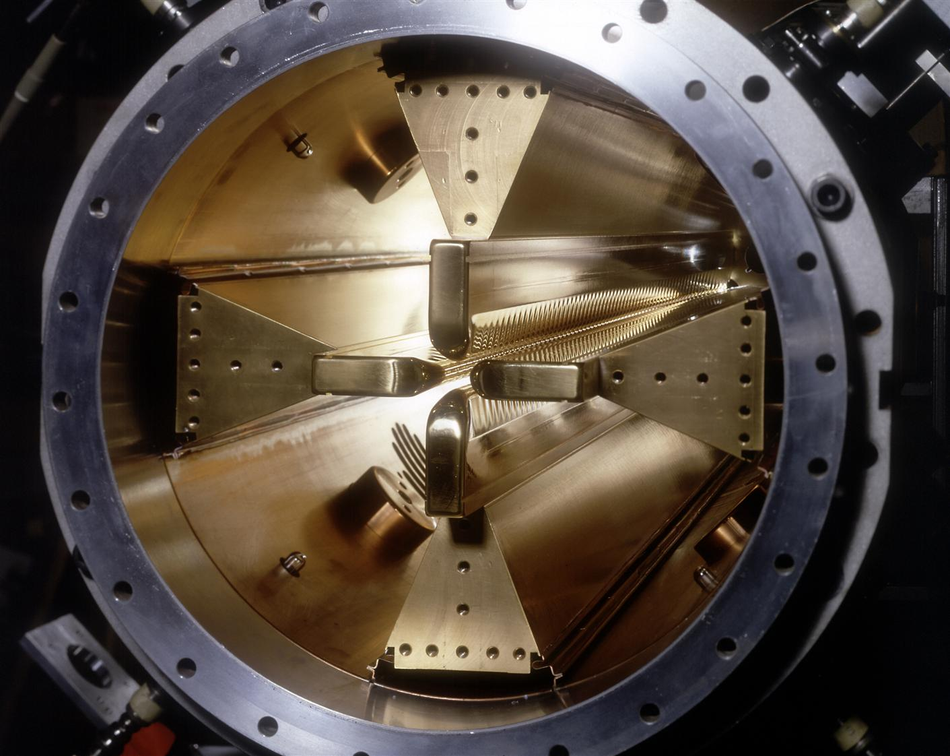
Radio Frequency Quadrupole
a look inside

Slide 16
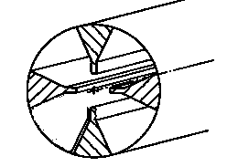
How does an RFQ work?
Four longitudinal electrodes make a quadrupolar, transverse electric field.
This field varies with the RF (200 MHz) – thus particles travelling down the axis see alternating focusing and defocusing quadrupoles. I.e. the RFQ can focus without magnets!
The electrodes have in axial direction a slight undulation – an axial component of the electric field results.
This axial electric field provides for both bunching and acceleration.

Slide 17
0.75 to 50 MeV – Linac 2
Length: 34 m

Slide 18
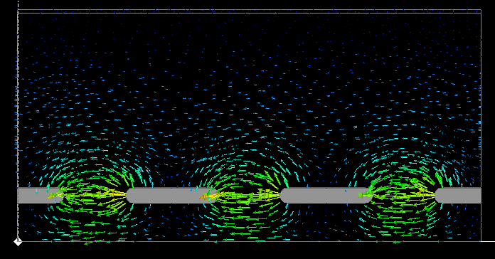

Drift Tube Linac
Inside a large cylindrical tank, drift tubes are suspended on stems.
An RF field is present inside the tank and between the tubes.
Particles travelling down the axis will be shielded from the field while inside a drift tube. The distances and lengths of the drift tubes are chose such that this happens when the RF phase of wrong.
To focus the beam, magnetic quadrupoles can be integrated with the drift tubes.
shown:
E-field
beam axis

Slide 19
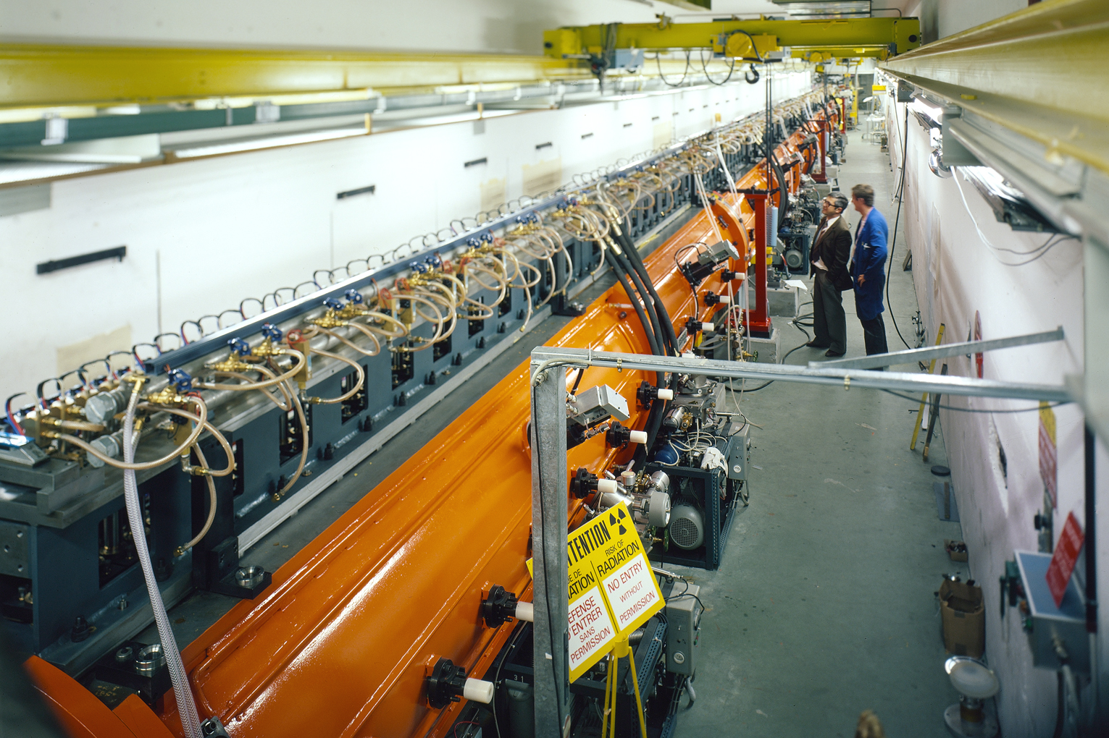
Linac 2
3 RF tanks, 34 m long, 200 MHz, RF 30 MW peak.

Slide 20
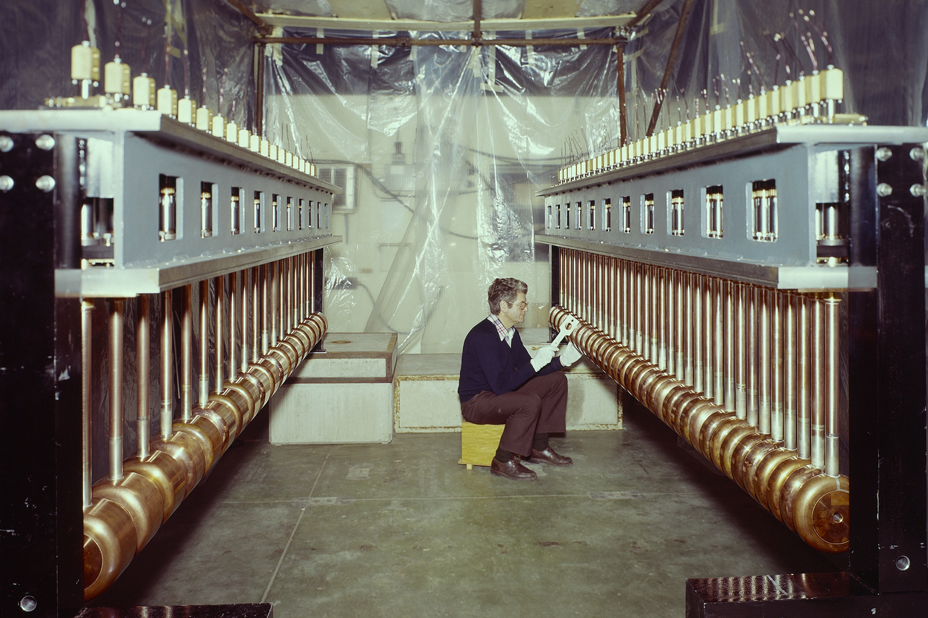
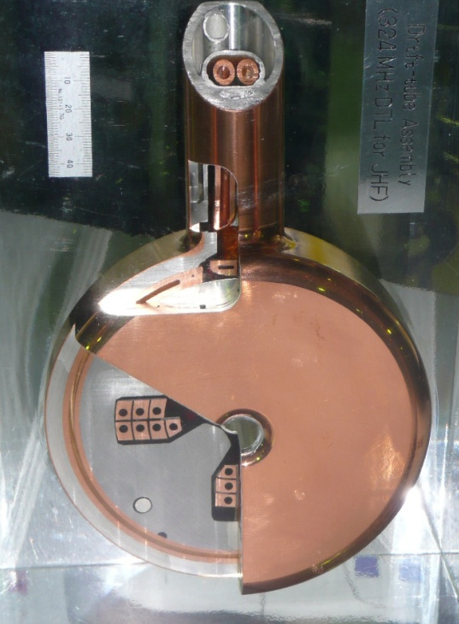
The drift tubes of Linac 2
drift tubes with incorporated quadrupoles,
JPARC JHF 324 MHz DTL

Slide 21
50 to 1400 MeV – PS Booster
Radius: 25 m (circumference 157 m), 4 rings stacked vertically

Slide 22
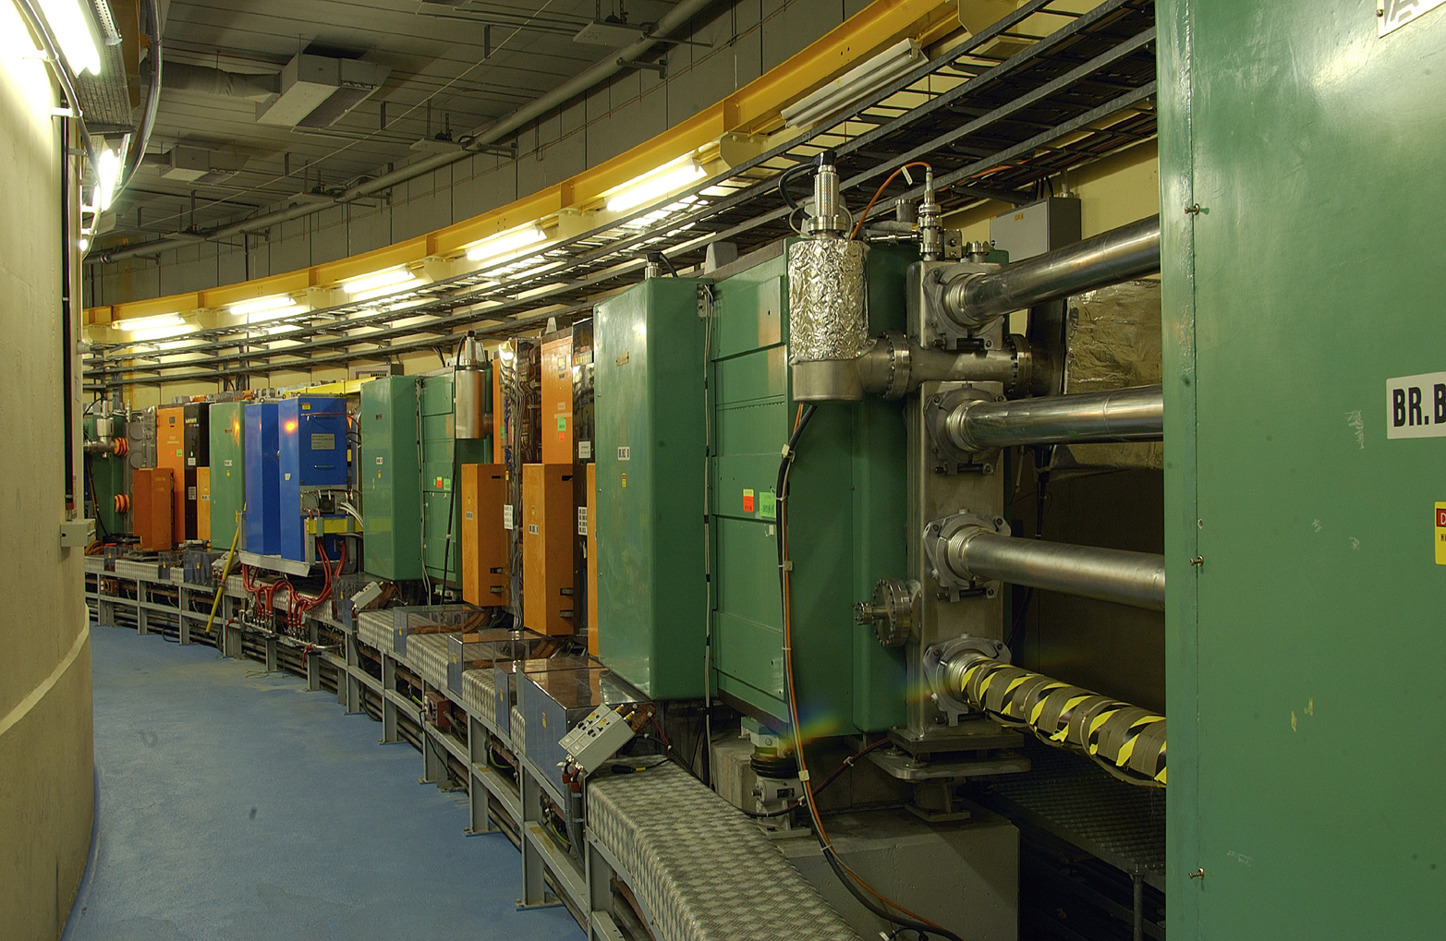
PSB
4 separate rings, 25 m radius.
Injection into the 4 rings is done sequentially and slowly (up to 20 turns per ring).
The PSB can store up to 4 10¹³ protons.
The Booster uses Ferrite Cavities in its RF systems.

Slide 23
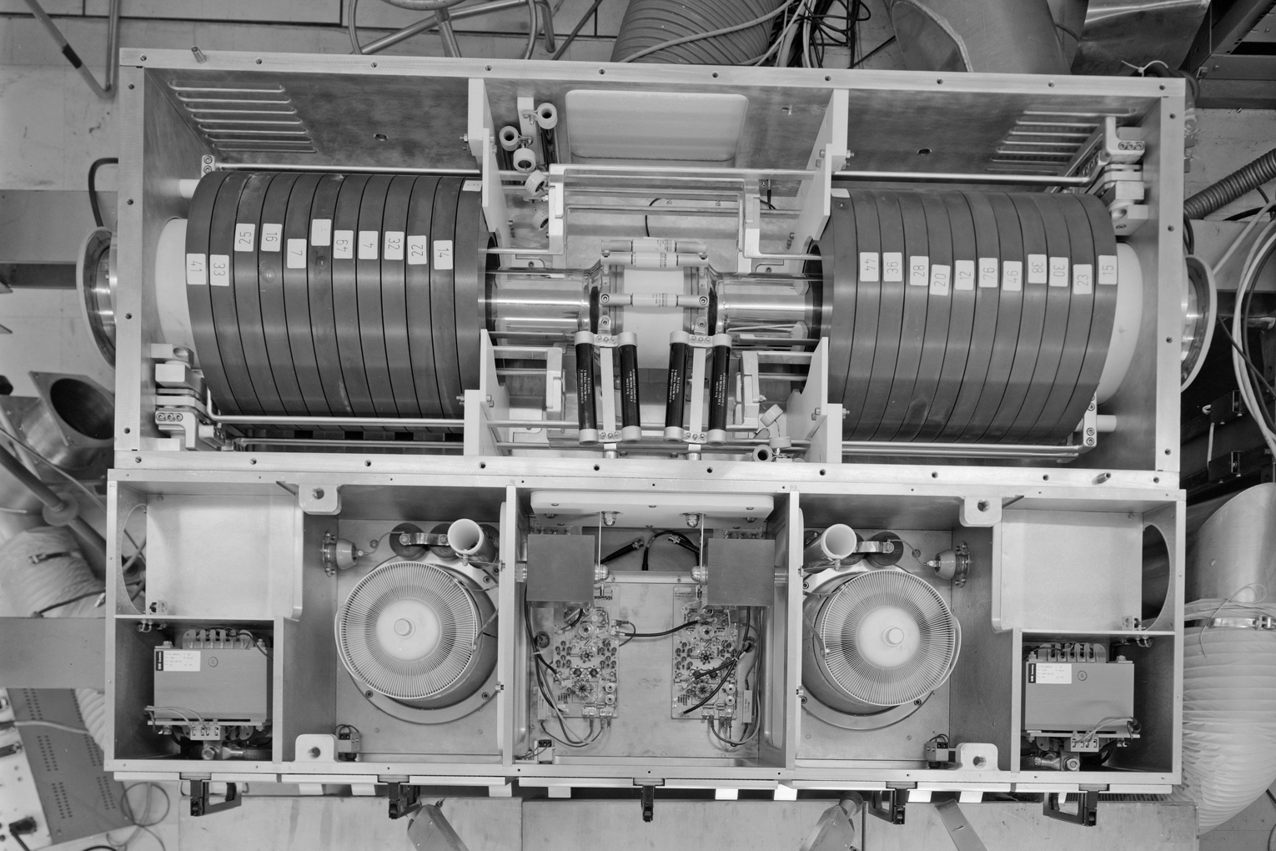
PSB cavity 3 … 8 MHz
1983
magnetic bias
Ferrite rings
accelerating gap
Final amplifier (tetrodes)

Slide 24
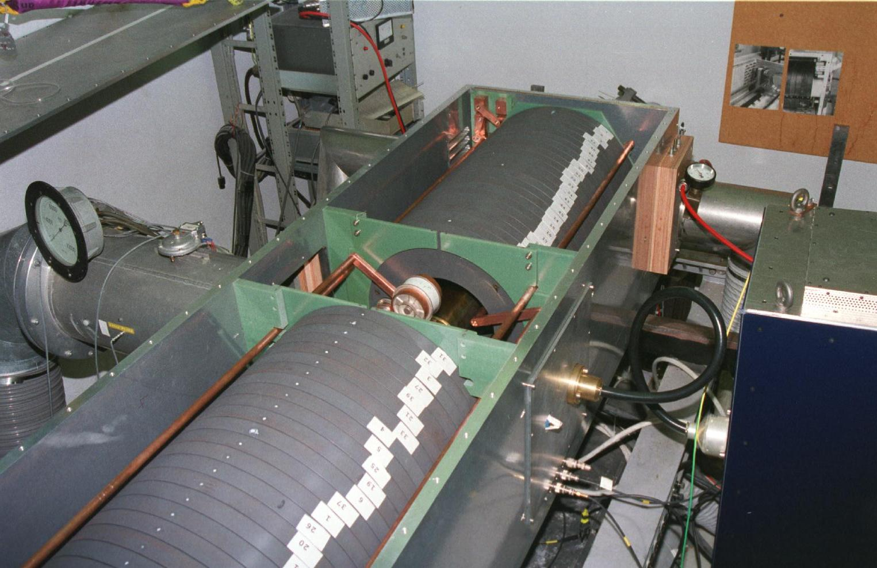
PSB cavity 0.6 … 2 MHz
1996
Ferrite rings

Slide 25
1.4 to 26 GeV – PS
Radius: 100 m (circumference 628 m = 4 x PSB)

Slide 26
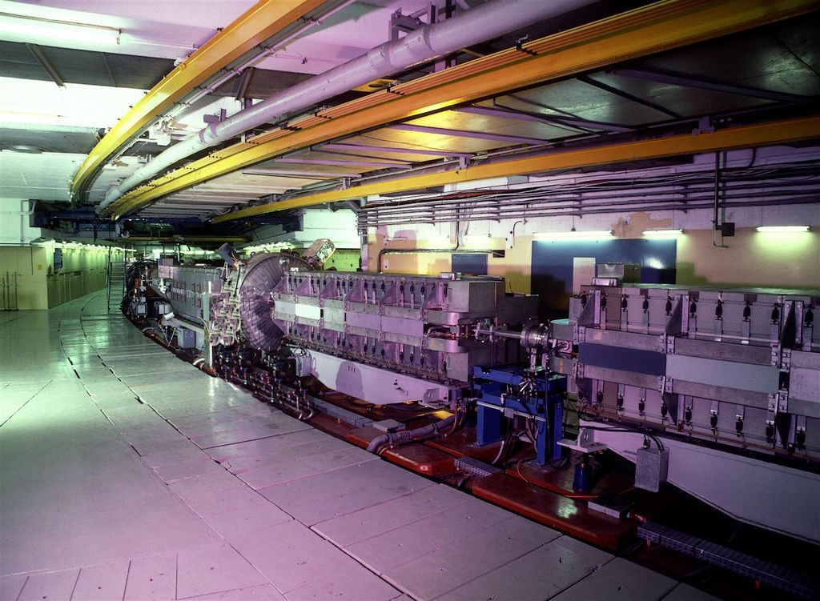
PS – Proton Synchrotron

Slide 27
Acceleration in a synchrotron
Acceleration happens inside cavity resonators.
The particles come in packages (bunches)
If h bunches fit on a circumference, the RF is h f_{rev}.
f_{rev} is the particle speed divided by the circumference.
cavity

Slide 28
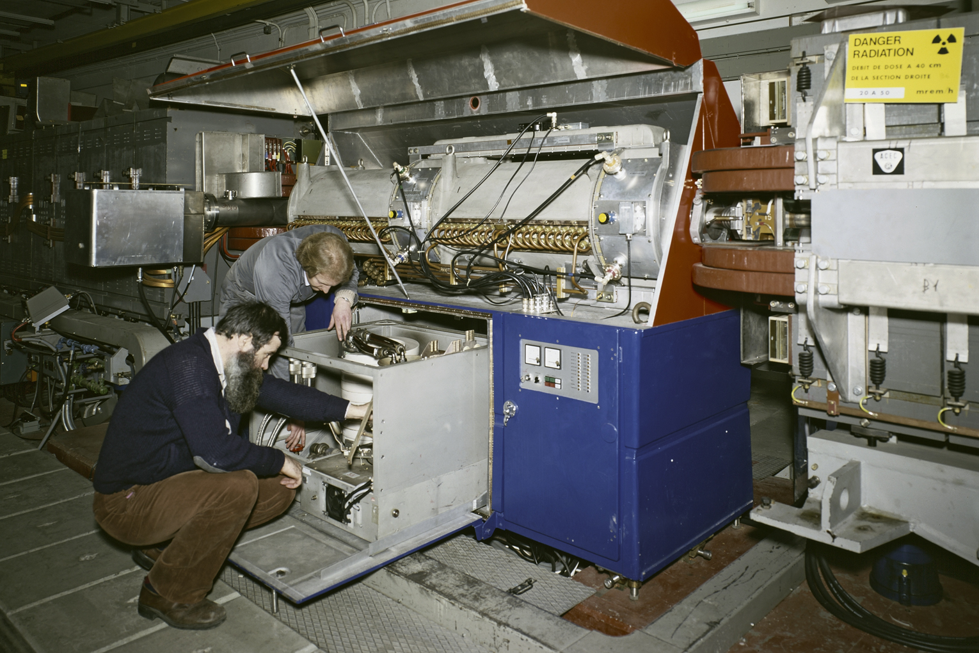
PS accelerating cavities

Slide 29
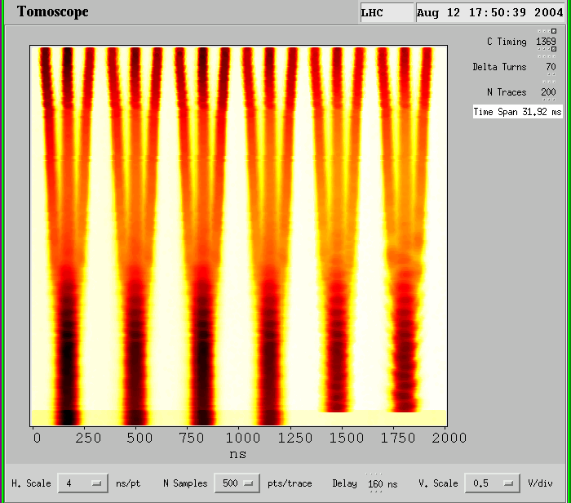
Longitudinal beam “gymnastics”
time
RF phase

Slide 30
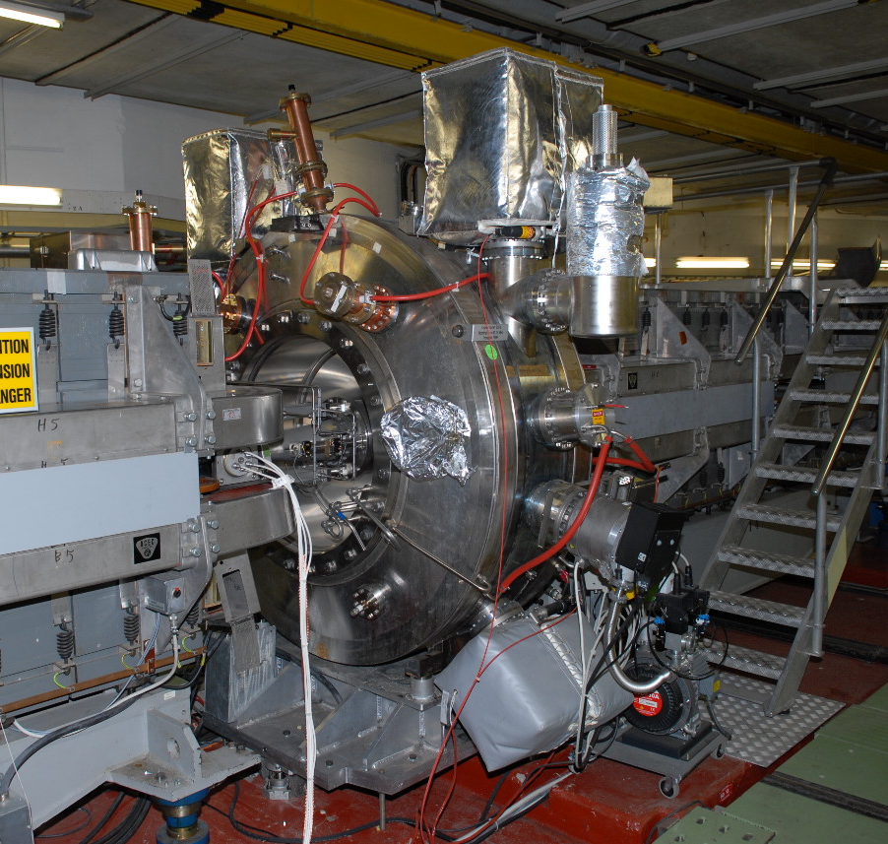
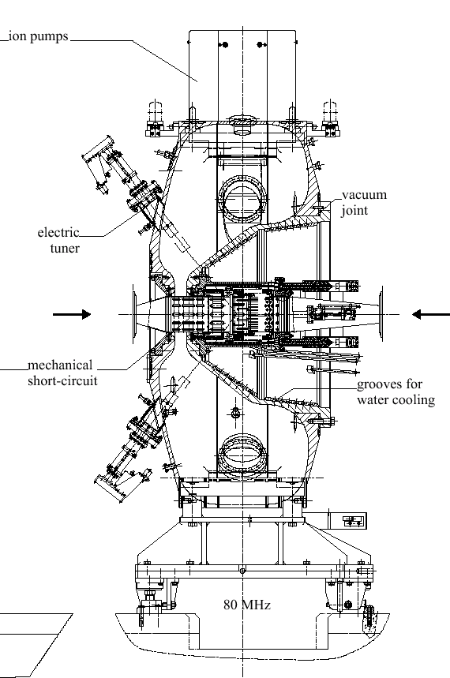
PS 80 MHz cavity

Slide 31
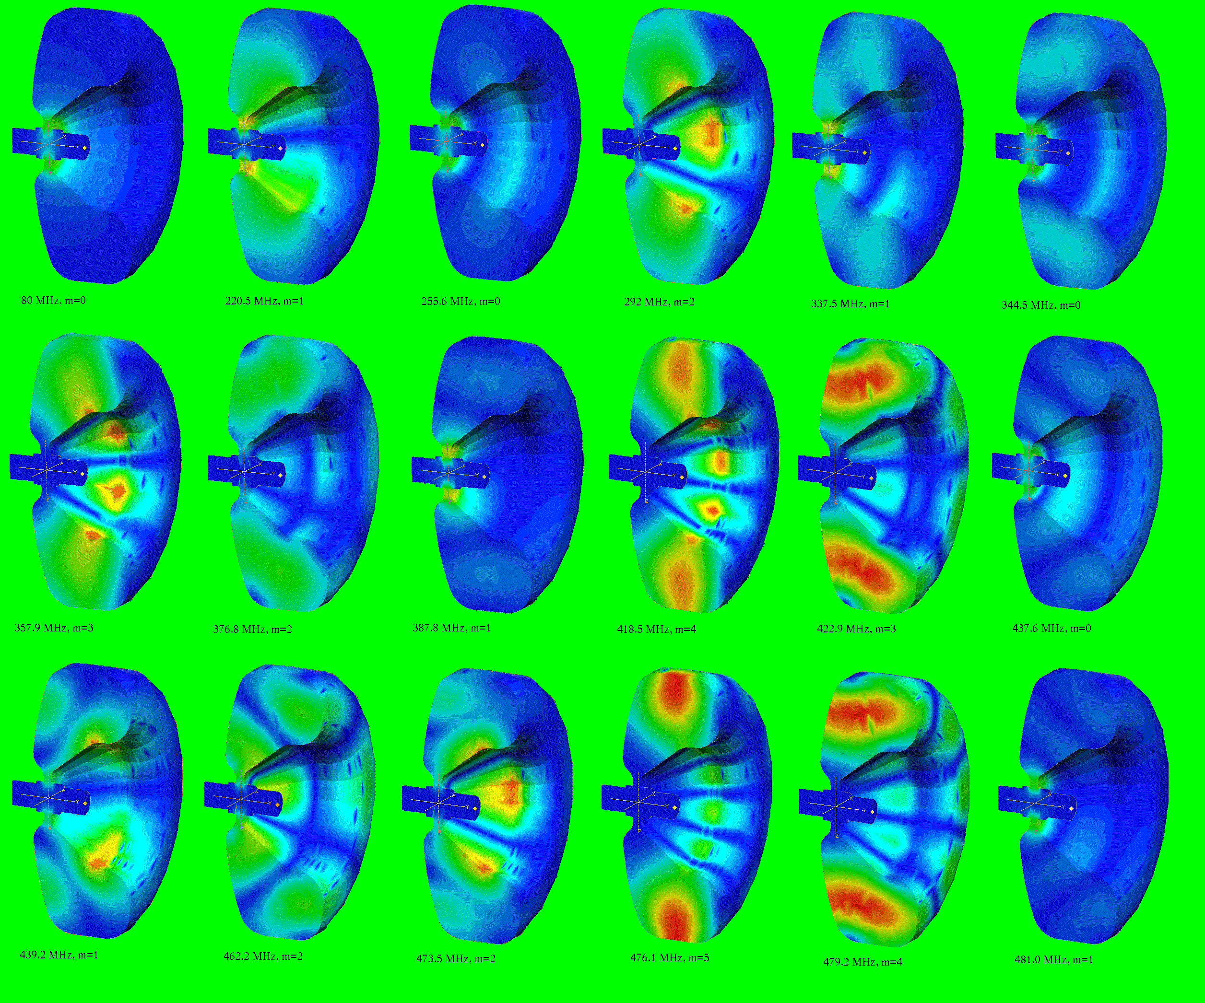
Higher Order Modes
In a cavity resonator, many “modes” can exist.
The cavity is designed to operate in the fundamental mode.
HOM’s can also interact with the beam and make it unstable.
In order to allow stable operation with large beam currents, HOM’s must be damped.

Slide 32
26 to 450 GeV – SPS
Circumference 6.911 km = 11 x PS)

Slide 33
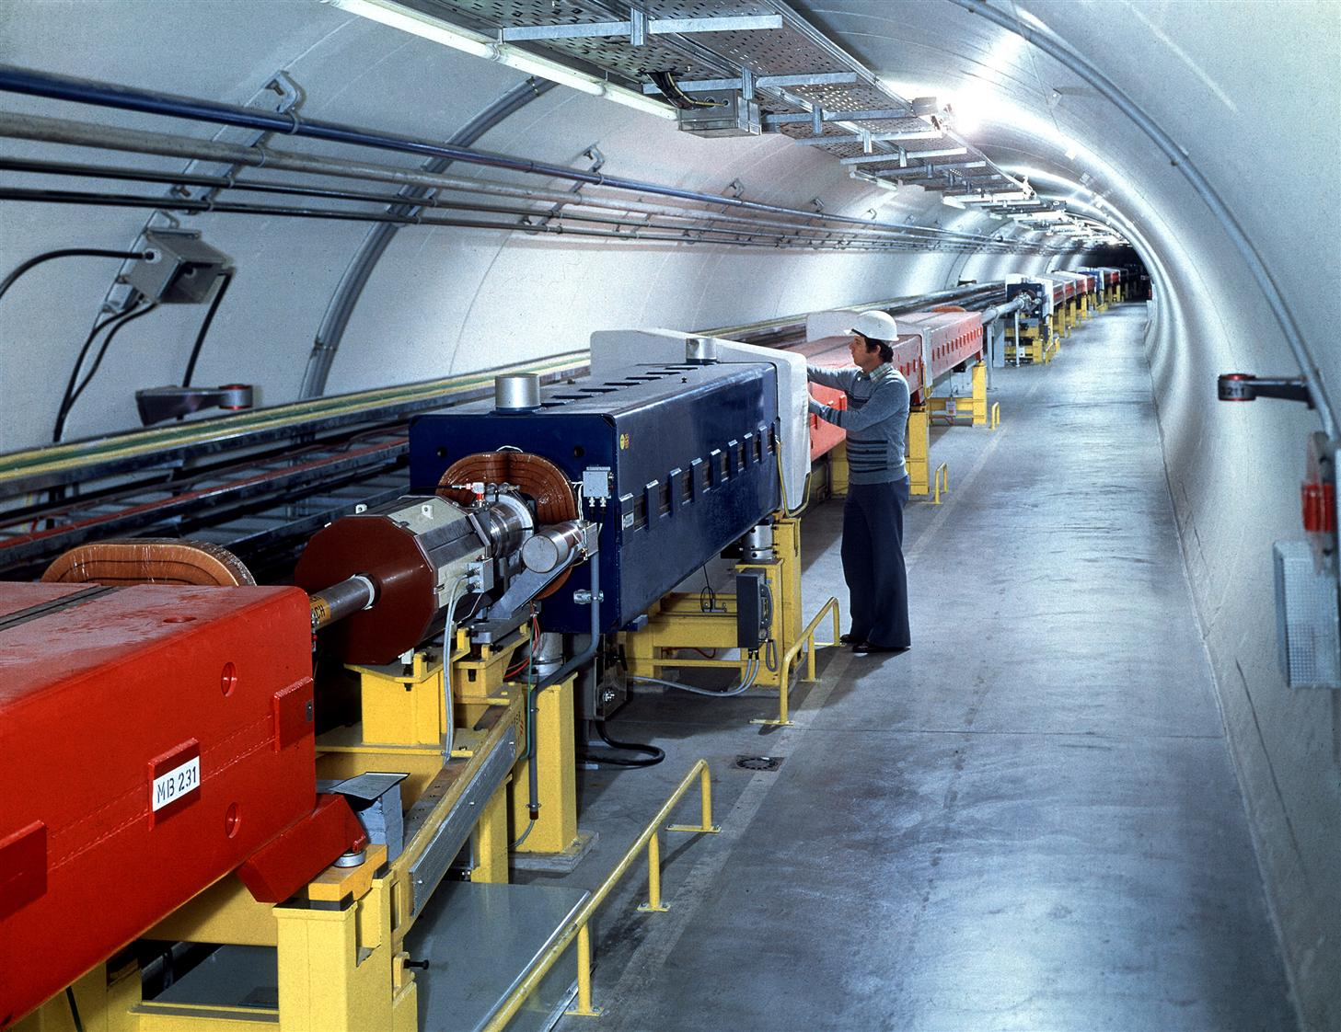
SPS tunnel

Slide 34
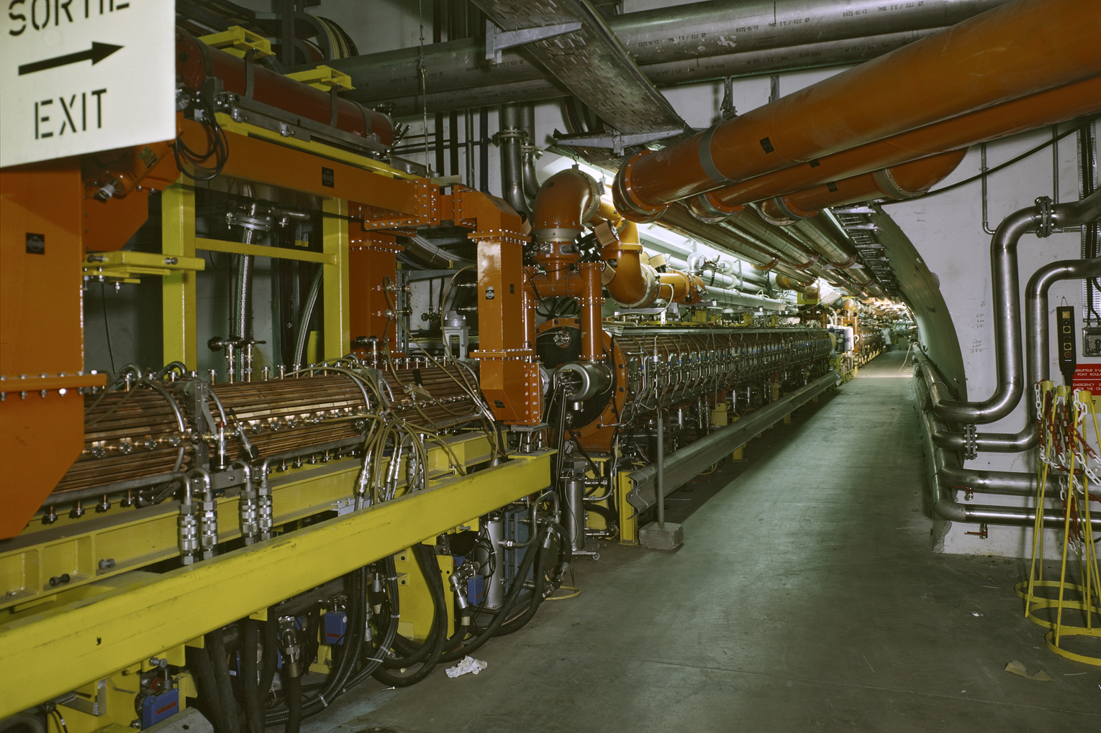
SPS accelerating cavities
800 MHz feeder line (rectangular WG)
200 MHz feeder line (coaxial)
200 MHz cavity
800 MHz cavity

Slide 35
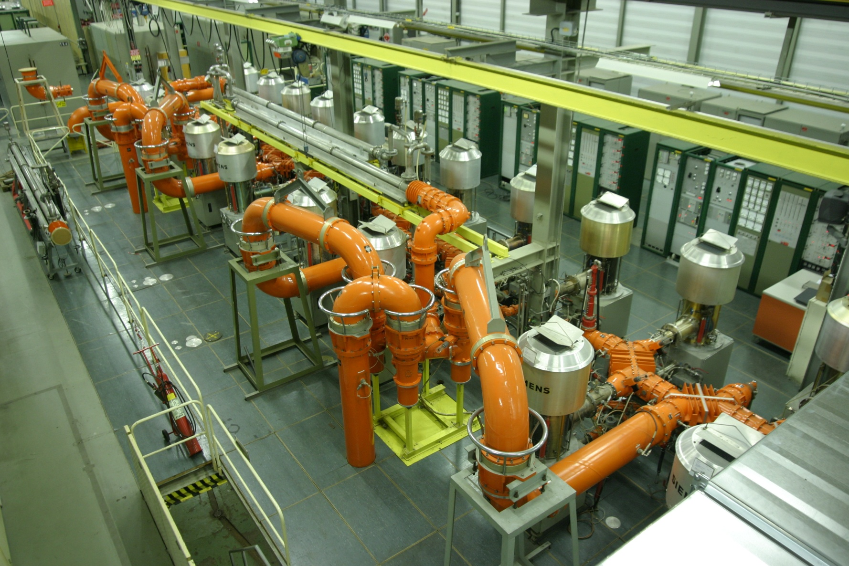
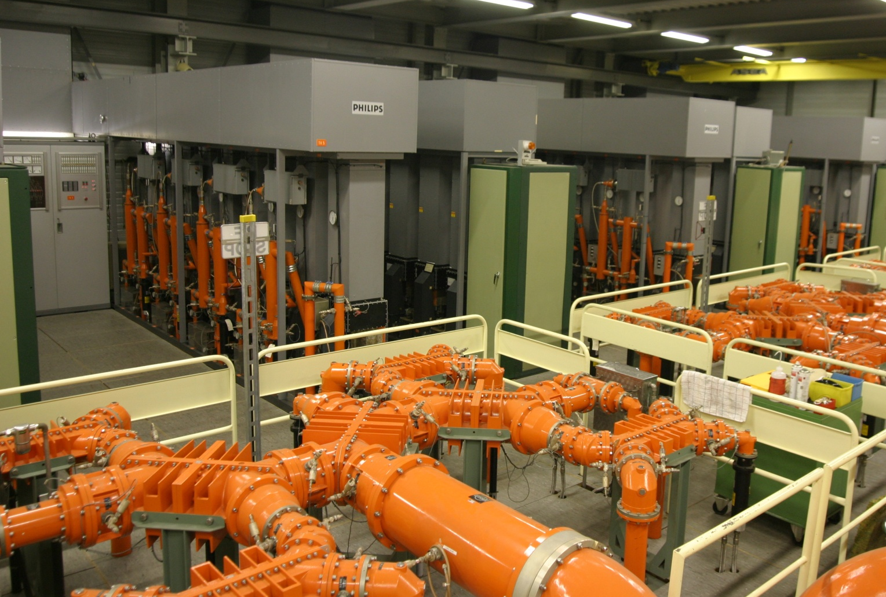
SPS Power sources
“SIEMENS”, 1.4 MW
20 high power tetrodes
“PHILIPS”, 1.6 MW
68 high power tetrodes

Slide 36
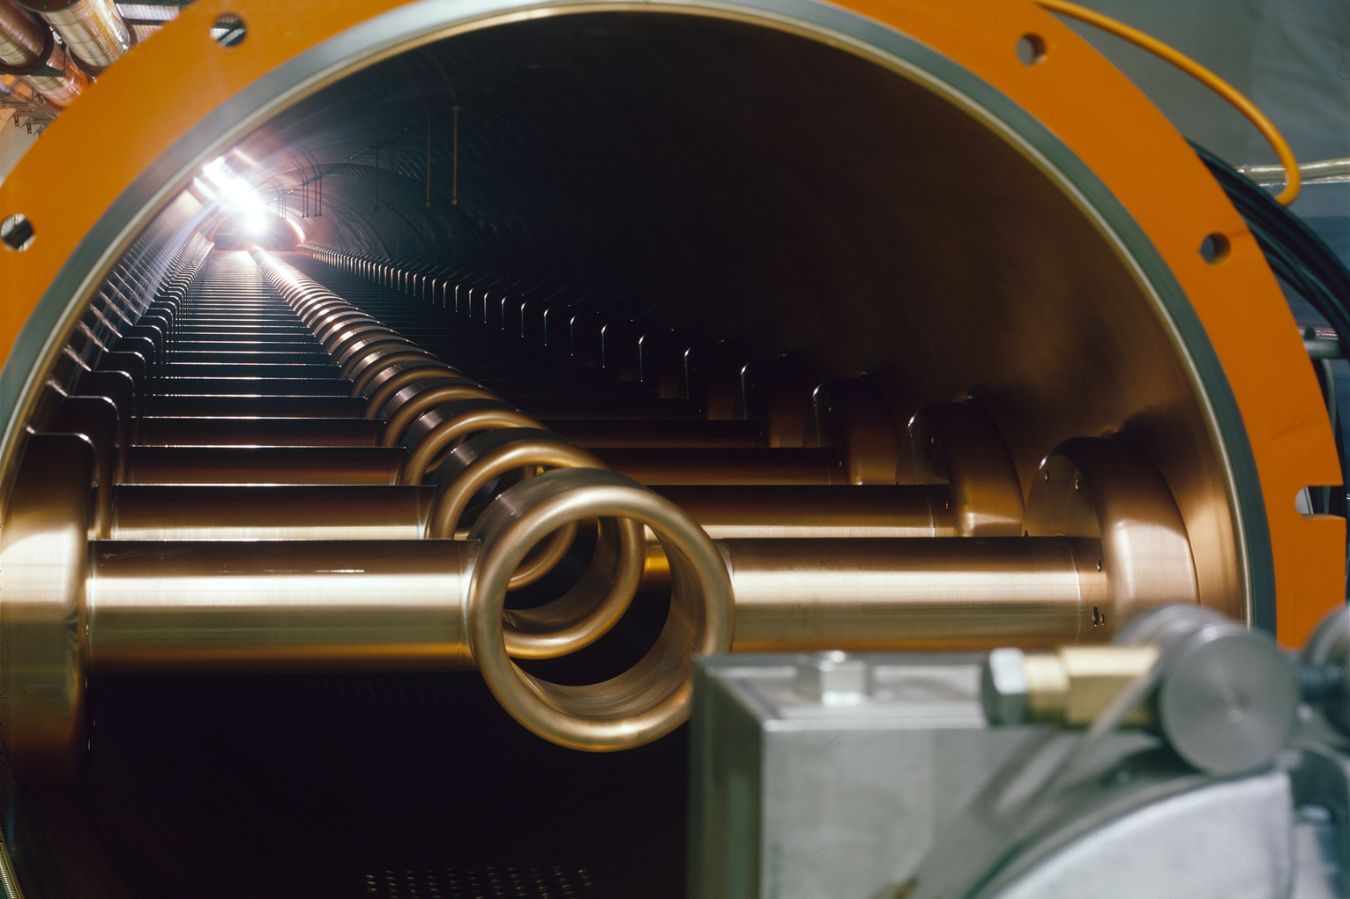
Inside the 200 MHz cavity
Travelling Wave Structure

Slide 37
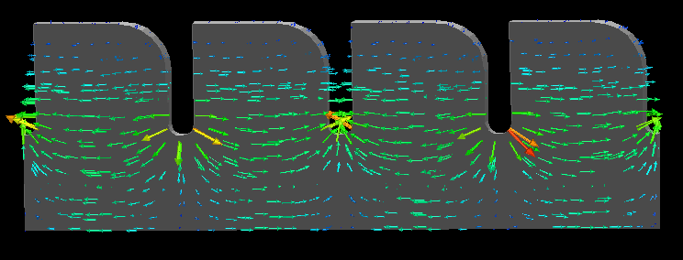
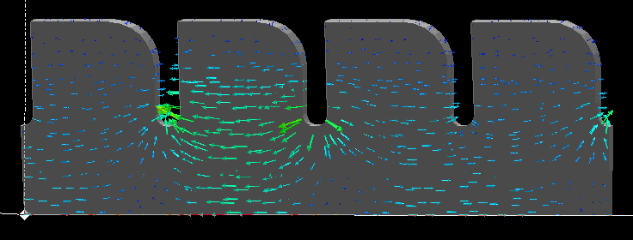
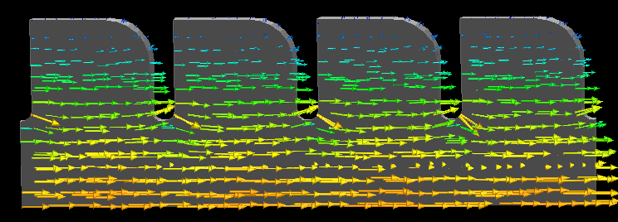
Travelling Wave structure – synchronous condition
ω L/c
π
2π
light line
ω = β /c
2π/3
π
synchronous
π/2
0
0
π/2
β L
π

Slide 38
0.45 to 7 TeV – LHC
Circumference 26.659 km =27/7 x SPS

Slide 39
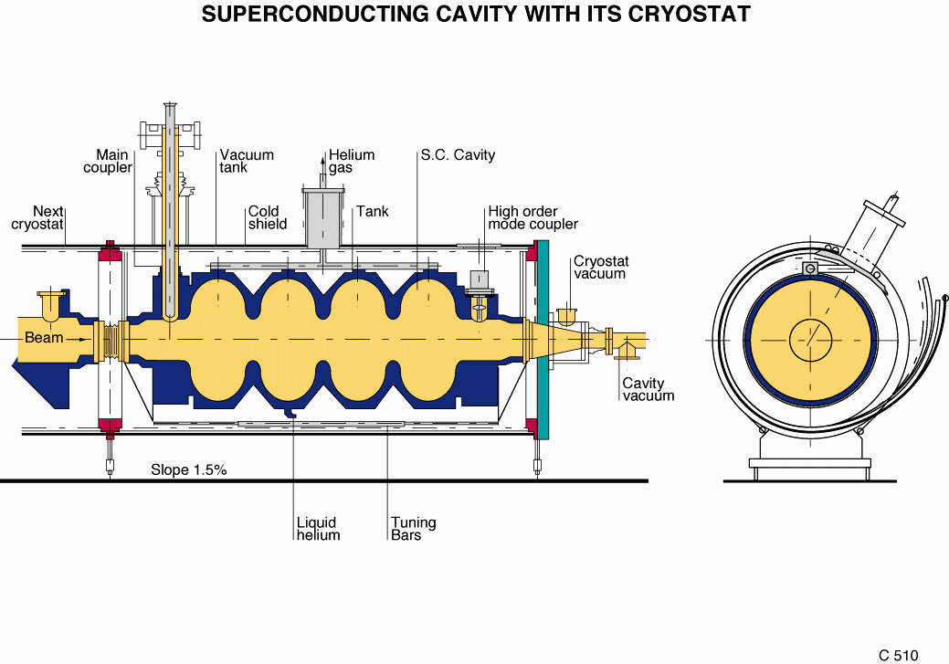
Superconducting Cavities

Slide 40
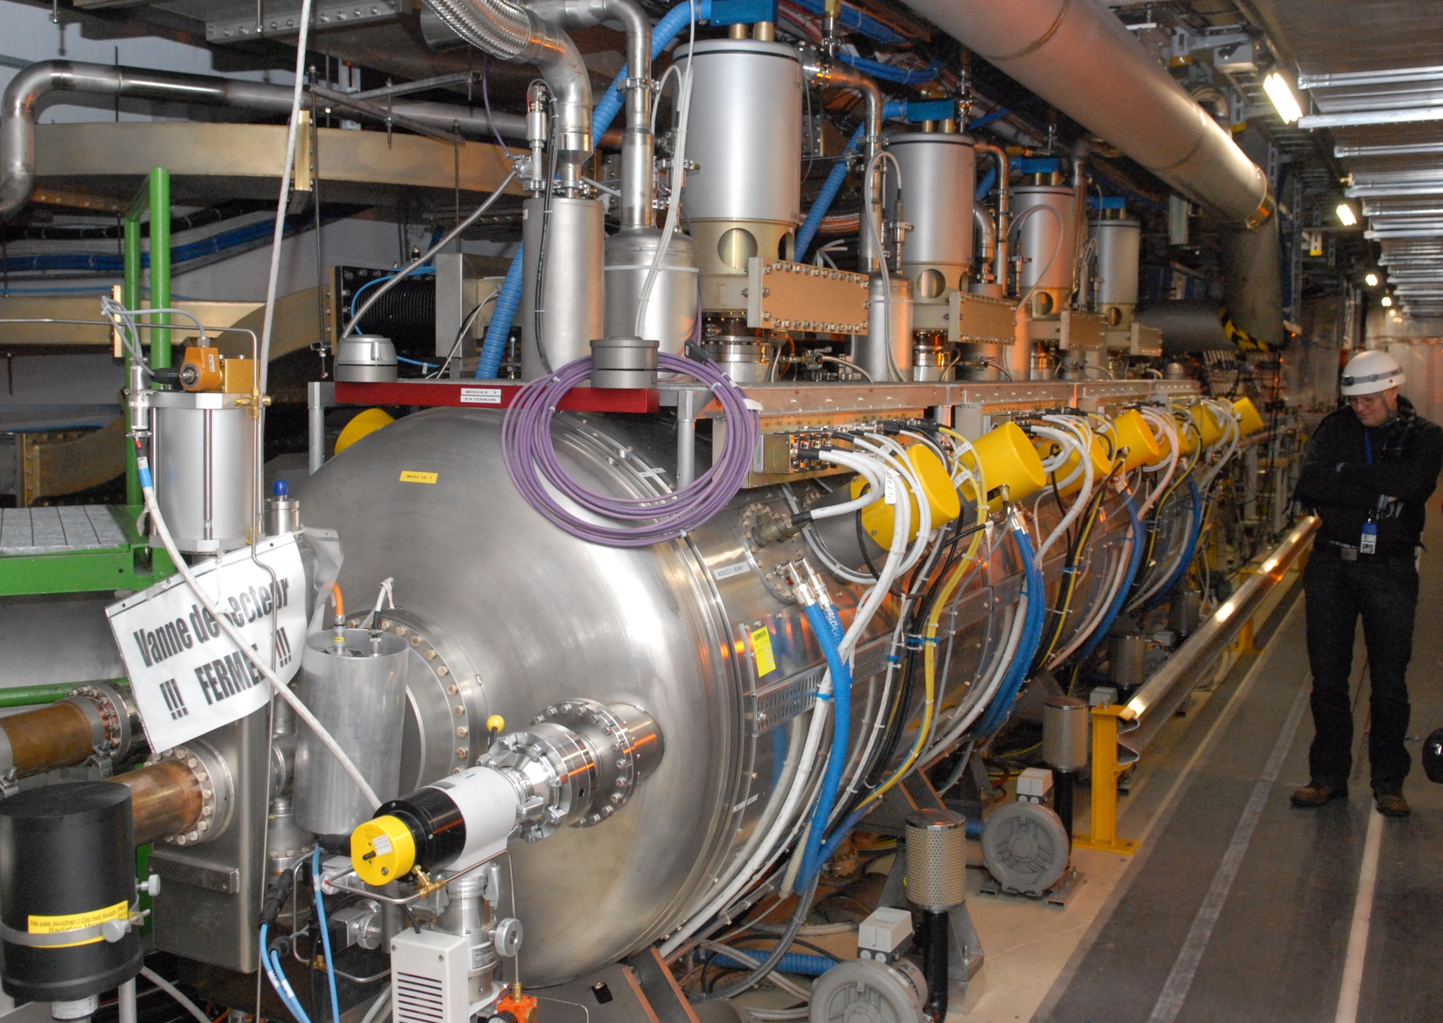
The LHC 400 MHz SC cavity

Slide 41
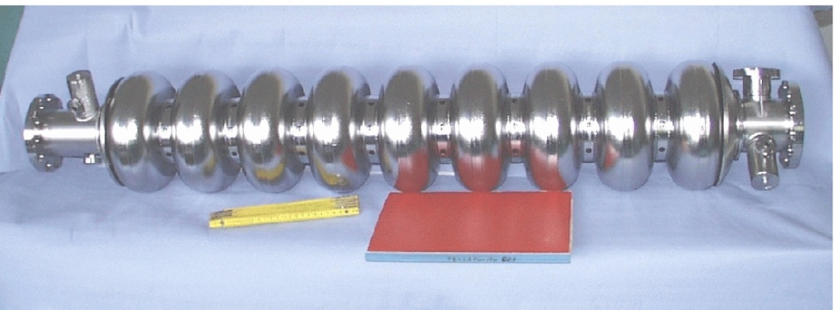
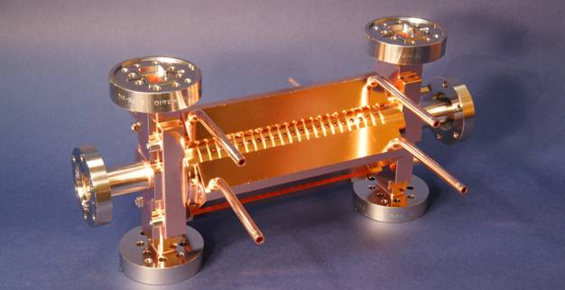
Linear Collider Concepts
ILC
CLIC
Supraconducting RF
Niobium cavities
1.3 GHz
31.5 MV/m
500 GeV c.m.
31 km long
Fed with 10 MW MBK’s
Room temperature RF
Copper cavities
12 GHz
100 MV/m
3 TeV c.m.
48 km long
Fed via a drive beam

Slide 42
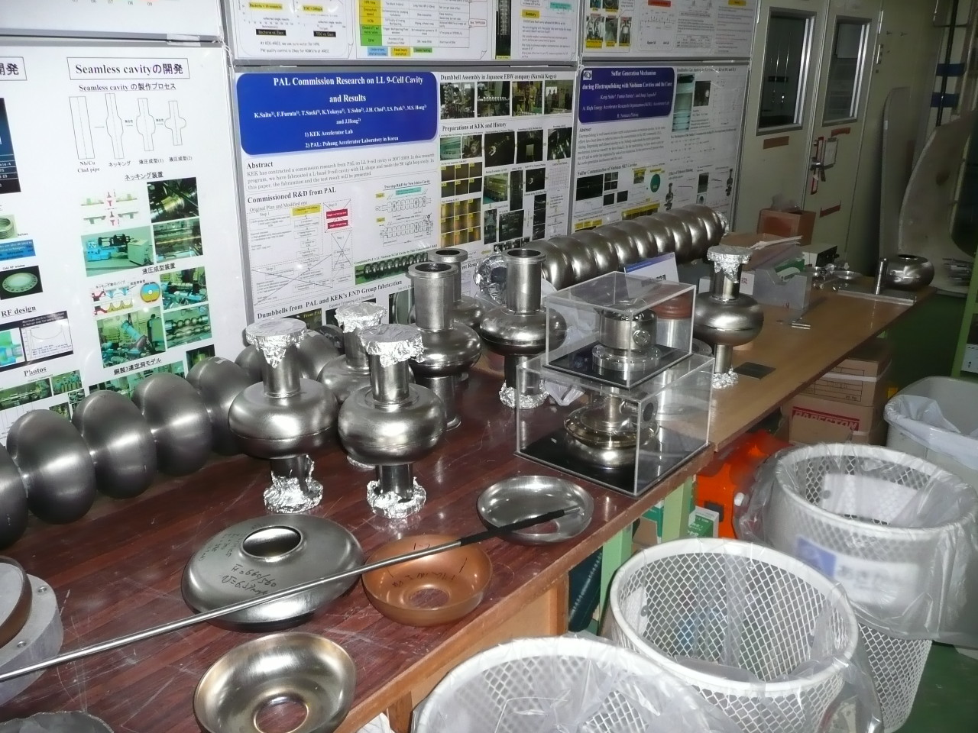
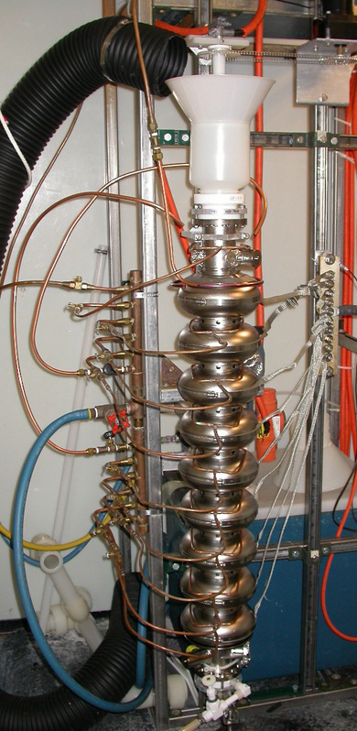
ILC – 1.3 GHz SC RF

Slide 43
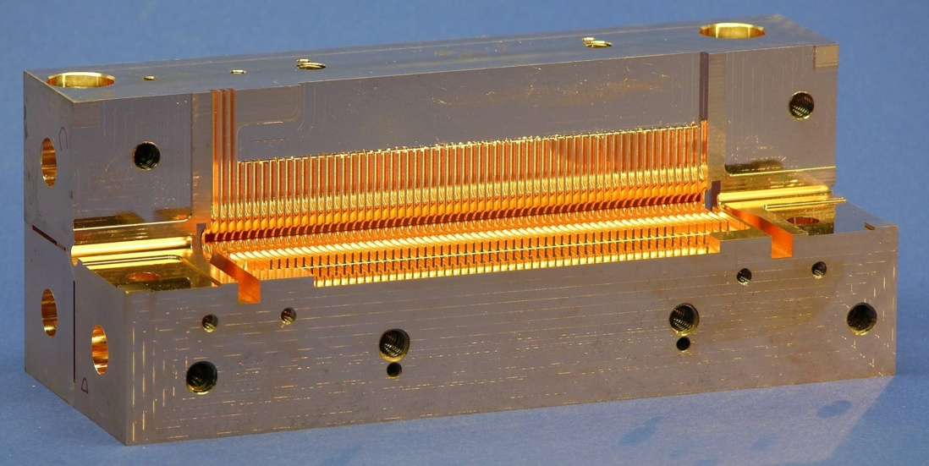
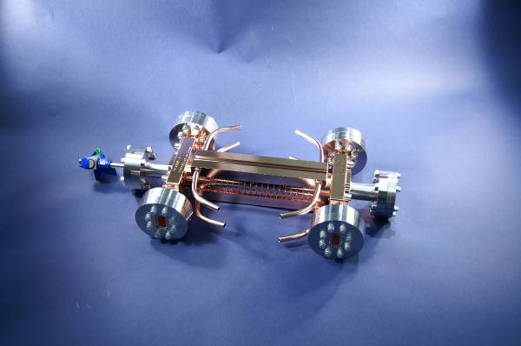
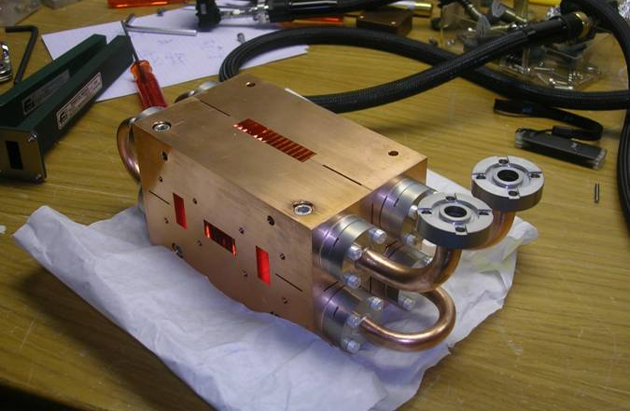
CLIC 12 GHz structures
“T18” (from bonded discs) – reached nominal gradient 100 MV/m.
Trying different fabrication technologies: quadrants instead of discs.

Slide 44
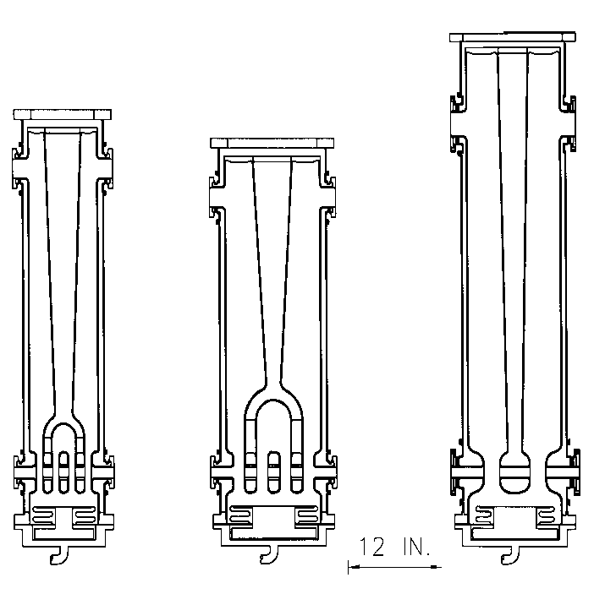
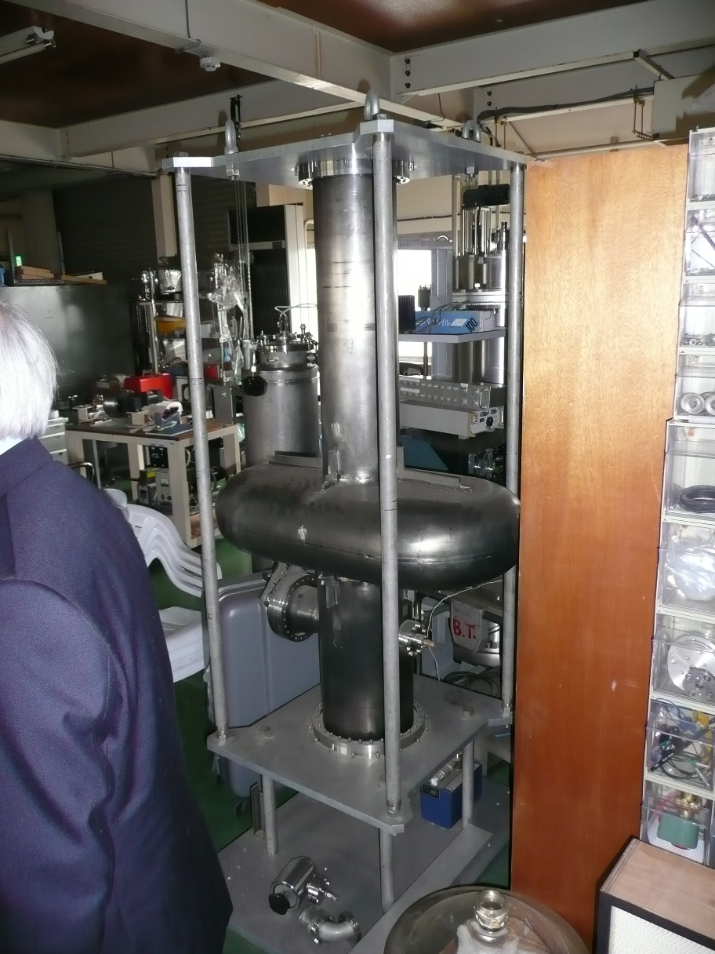
More exotic cavities
SC fork (left) and quarter-wave cavities (57 MHz) for slow particles (β=0.03)
KEK-B SC deflecting cavity (508 MHz)

Slide 45
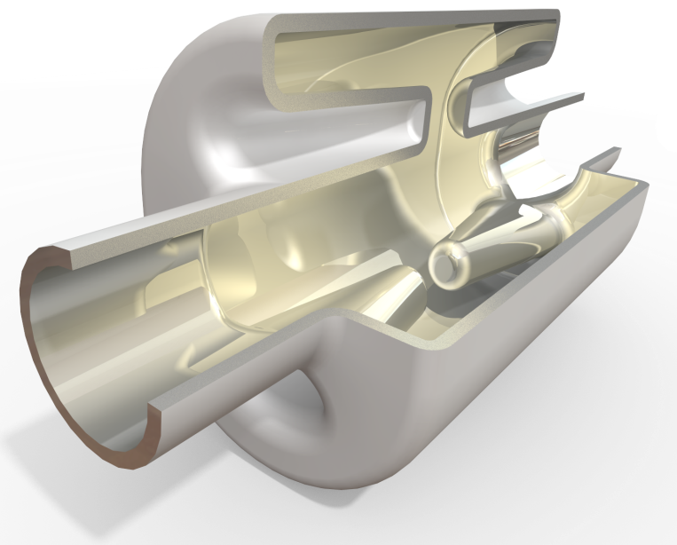
Crab Cavities for LHC upgrade
Old Dominion University design (J. Delayen)
Idea of crab crossing
SLAC design (Z. Li)
University Lancaster design (G. Burt)

Slide 46
Summary
Walking through the LHC injector chain, you heard about Cavity Resonators:
  RFQ
  Ferrite cavity (PSB, PS, …)
  Single gap vacuum cavity (PS 80 MHz)
  Travelling wave structure (SPS 200 MHz)
  Superconducting cavity (LHC 400 MHz)
You also saw some other Cavities:
  ILC – CLIC – low beta SC cavities – deflecting cavities
Thank you for your attention!

